Slide 1
The state of post-training
Nathan Lambert
interconnects.ai // Ai2
3 January 2025

Slide 2
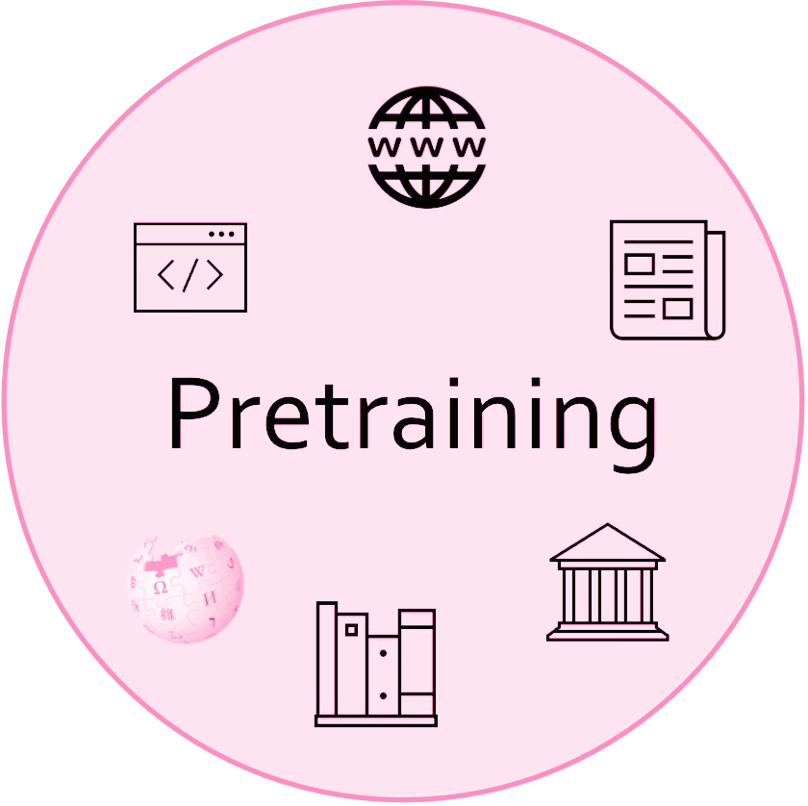
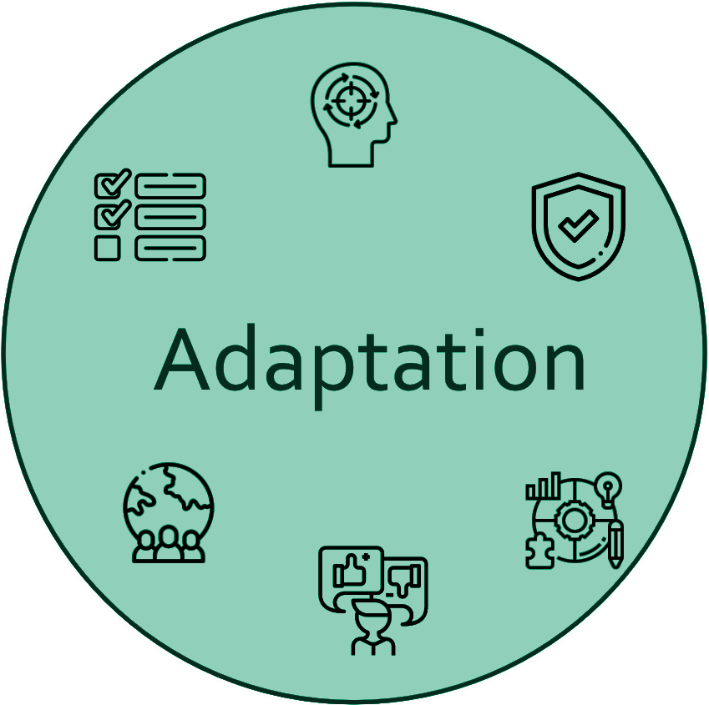
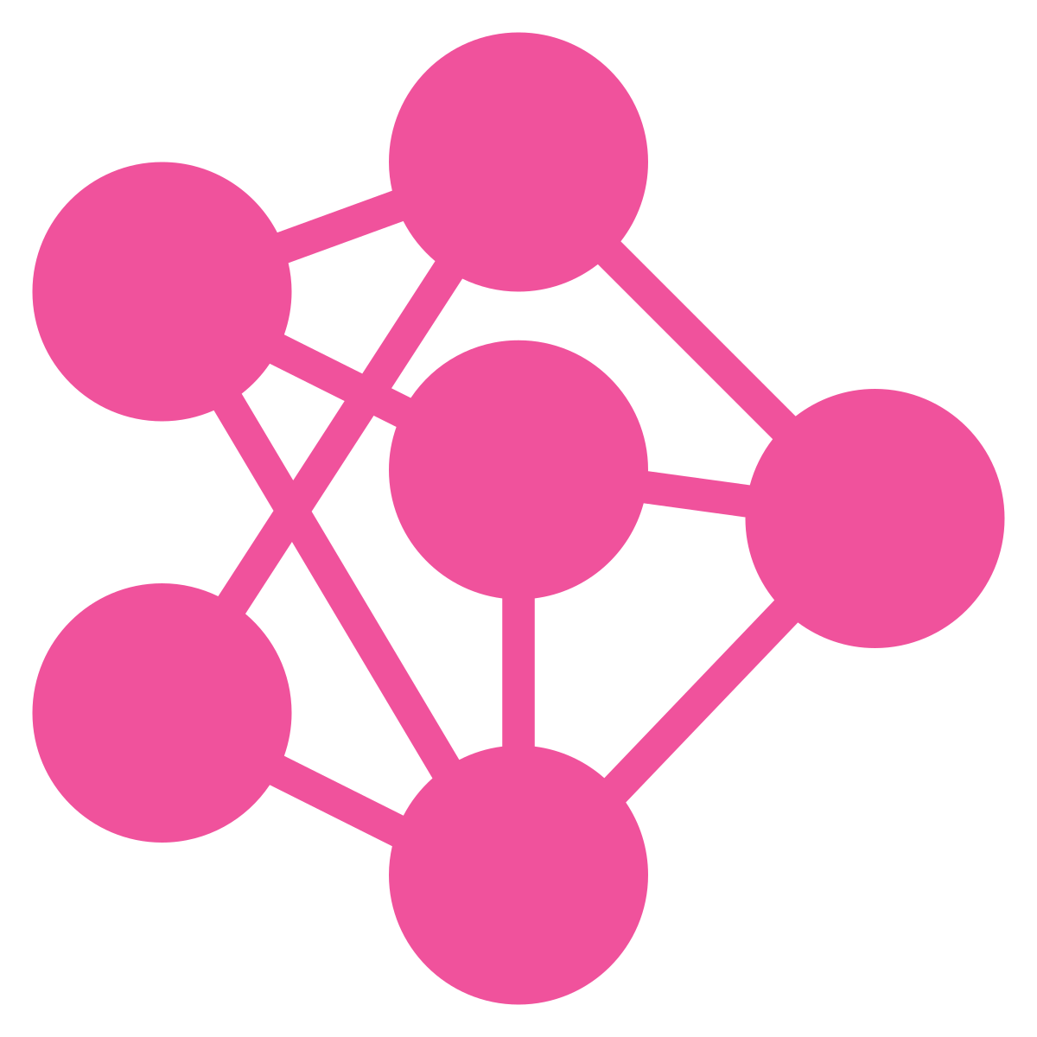
Language model adaptation
The raw pre-trained LMs are neither safe nor robust for public use and interactions, thus require “alignment” between AI and humans.
Follow natural language instructions
Be aware of harmful behaviors
Respond according to human preference
Improve core skills

Slide 3
State of open recipes for fine-tuning
Post-training is far more complicated and grand in scope than in 2023.
We have a better documentation of the methods used in frontier-model post-training, but not the details (e.g. data).

Slide 4
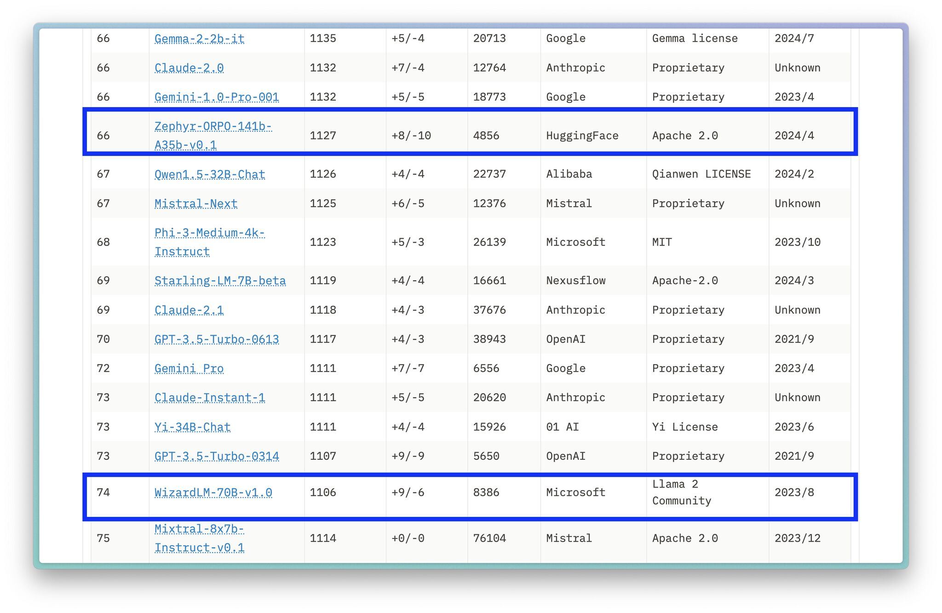
State of open recipes for fine-tuning
No models in the top 60 of LMSYS ChatBotArena with open fine-tuning data.
We can change this!
(As of Dec. 9th, 2024 – OLMo + Tülu should change this in 2025!)

Slide 5
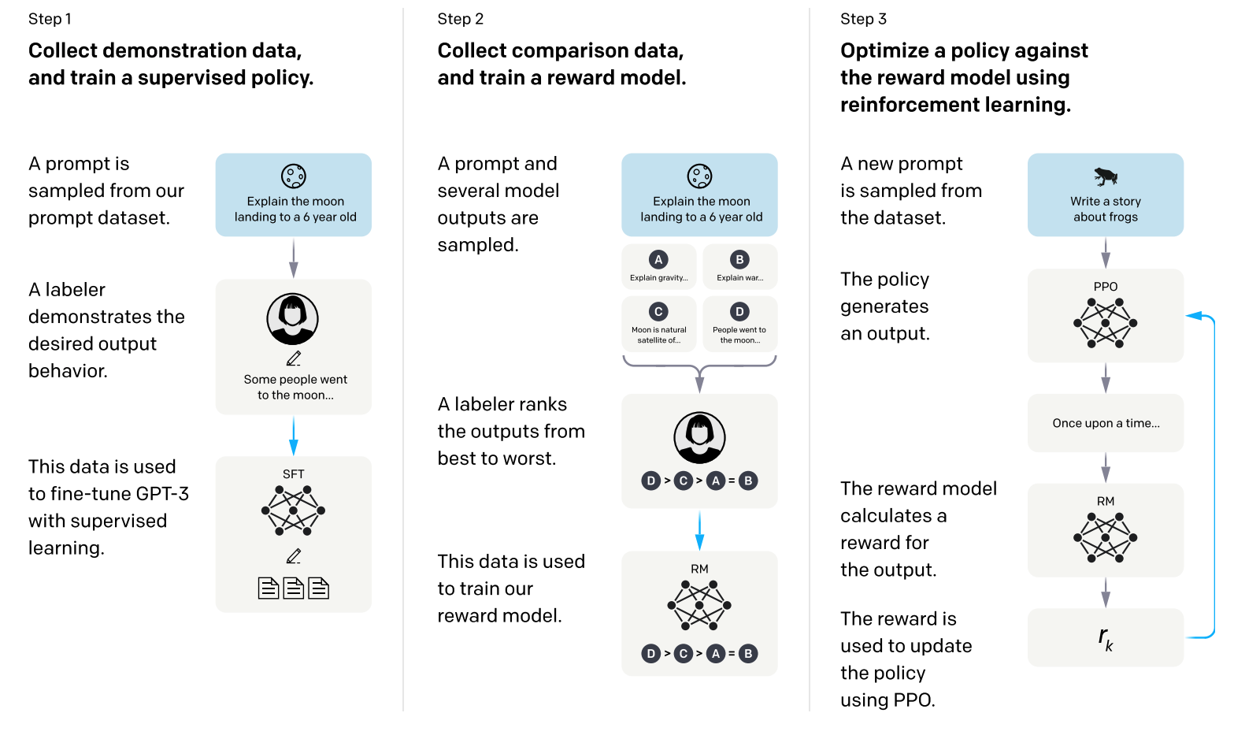
Initial approaches to modern post-training
ChatGPT blog post:
We trained this model using Reinforcement Learning from Human Feedback (RLHF), using the same methods as InstructGPT⁠, but with slight differences in the data collection setup.
Ouyang et al. 2022. InstructGPT.

Slide 6
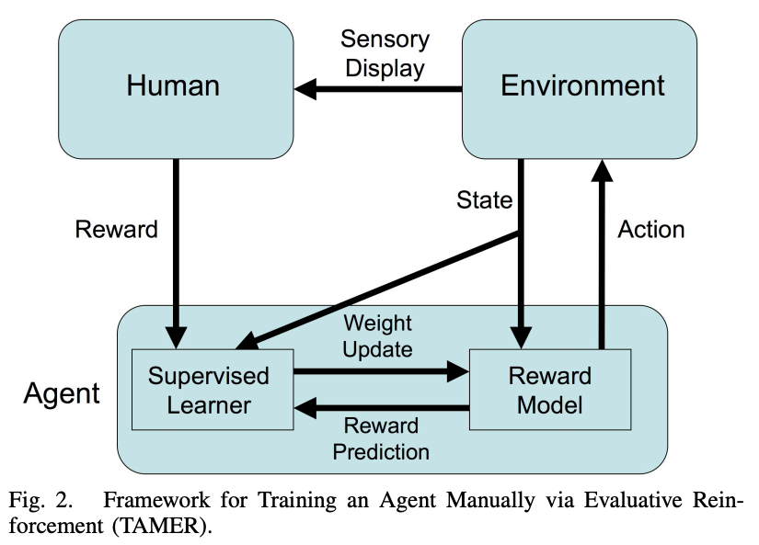
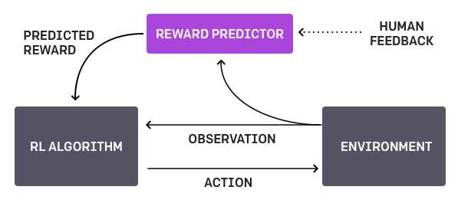
History: RLHF for decision making
Pre Deep RL
For Deep RL
Christiano, Paul F., et al. "Deep reinforcement learning from human preferences." 2017.
Knox, W. Bradley, and Peter Stone. "Tamer: Training an agent manually via evaluative reinforcement." 2008.

Slide 7

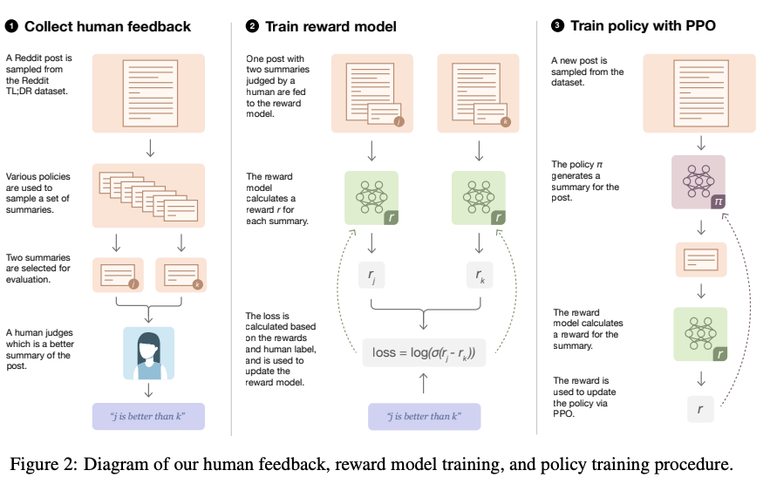
History: early OpenAI experiments with RLHF
“Three pigs defend themselves from a mean wolf”
Stiennon, Nisan, et al. "Learning to summarize with human feedback." 2020.

Slide 8
History: early OpenAI experiments with RLHF
📓Vanilla LM:
I’m considering pursuing a PhD in Computer Science, but I’m worried about the future. I’m currently employed full-time, but I’m worried about the future.
Prompt:
To pursue a Computer Sc. PhD or continue working? Especially if one has no real intention to work in academia even after grad school ...
🤖RLHF Model:
Currently employed, considering pursuing PhD in Computer Science to avoid being stuck with no residency visa ever again. Has anyone pursued a PhD purely for the sake of research, with no intention of joining the academic world?
+ =
✍️ Human Annotation:
Software Engineer with a job I’m happy at (for now), deciding whether to pursue a PhD to improve qualifications and explore interests and a new challenge.
Notes:
Rather self-explanatory post, but just to elaborate a little further...
Has anyone, after working for a period of time, decided for whatever reasons to head back into academia to pursue a PhD in Computer Sc, with no intention to join the world of academia but intend to head back into the industry? If so, what were the reasons. Also, how did it turn out? Was there anything that you regretted? Did it work out?
The reason I’m asking for advice is because currently I’m employed full-time, and know how fortunate I am to have a job in these hard times. However, being from a foreign country and working in the UK, they are making it difficult for one to extend one’s working visa because I do not possess a Masters/PhD and only a Bachelor’s.
It’s just a little frustrating because I have been here almost half a decade now, but I have been sitting on a visa that has no count towards residency and soon, I will have to apply for a visa with even more restrictions.
I’m thus considering boosting up my paper qualifications, so as to prevent myself from being in such a situation ever again. I believe the stipend from grad school actually pays almost as much as I am earning now (in terms of spending power, not direct currency conversion), but of course, given if I spent 5 years working as opposed to studying, there might be opportunities for raises/promotions.
Obviously, plunging into a PhD solely for that reason is bound to get looks of disapproval. I am, of course, interested in expanding my knowledge and having an opportunity to have time for myself. I have had research experience (published a paper, presented at conferences) so I’m aware of the challenges research presents.
Any advice from people who have gone through similar situations? Would love to hear from you.

Slide 9
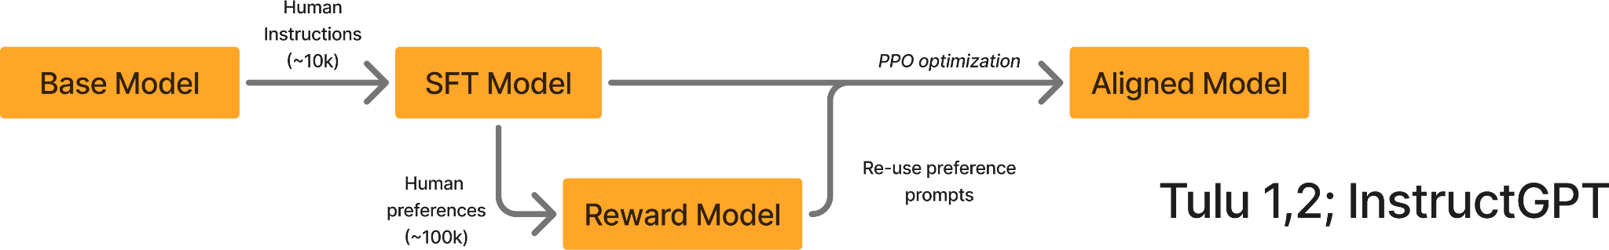
Initial approaches to modern post-training
From: https://www.interconnects.ai/p/frontier-model-post-training

Slide 10
Initial approaches to modern post-training
Three stage approach:
Instruction tune base model.
Collect preference data & train reward model.
Fine-tune with RL.
Focus on general chat capabilities (this was new at the time!)

Slide 11
Current frontier model post-training
Complex process for:
Addressing many capabilities and evaluations.
Leveraging synthetic data and scaled human data pipelines.

Slide 12
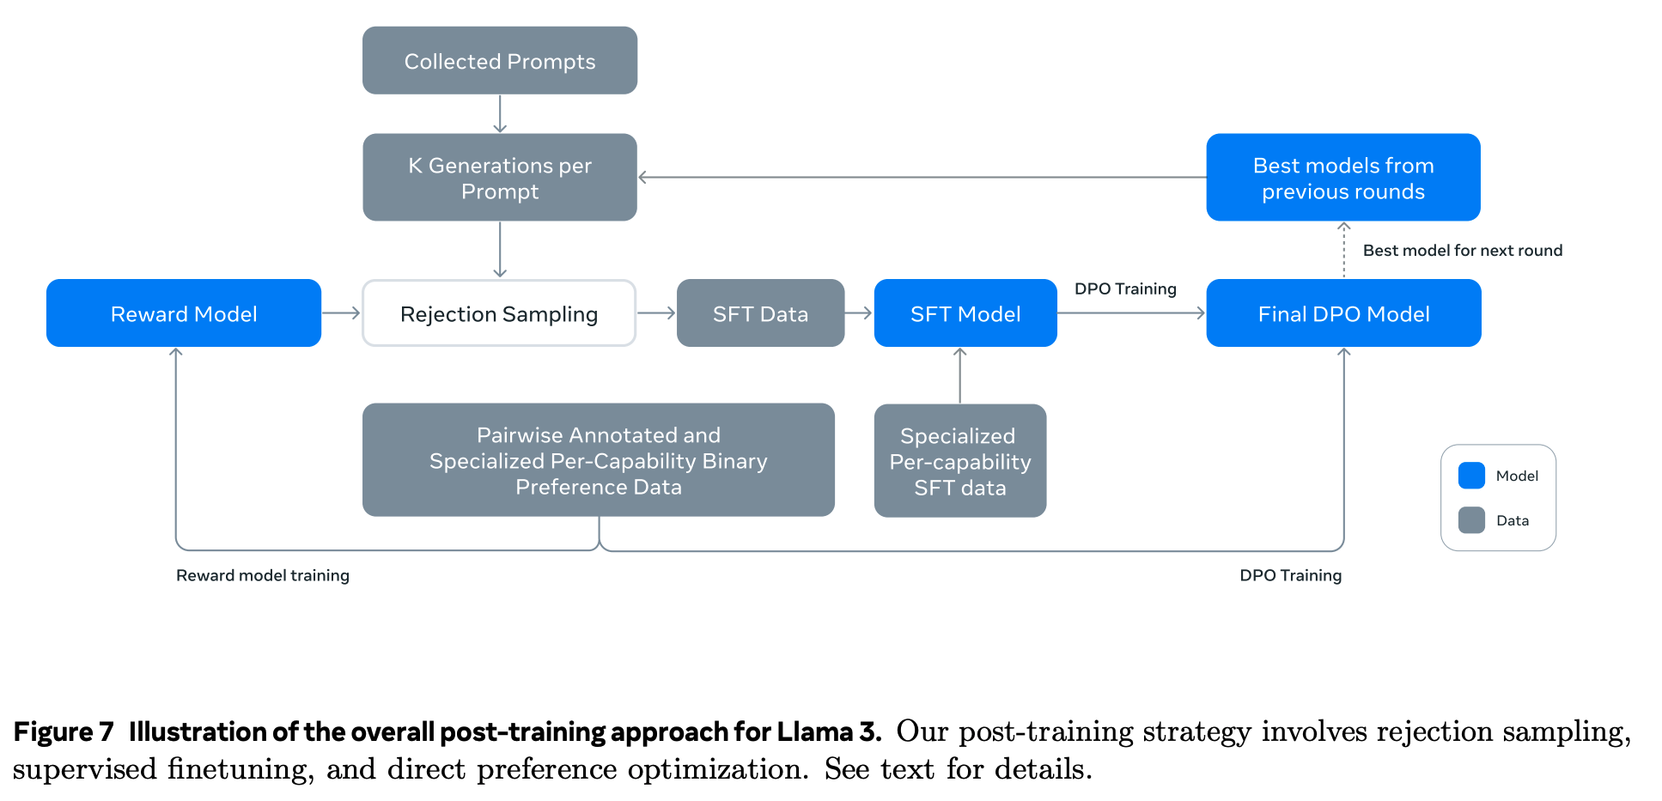
Current frontier model post-training
Dubey, Abhimanyu, et al. 2024. Llama 3.

Slide 13
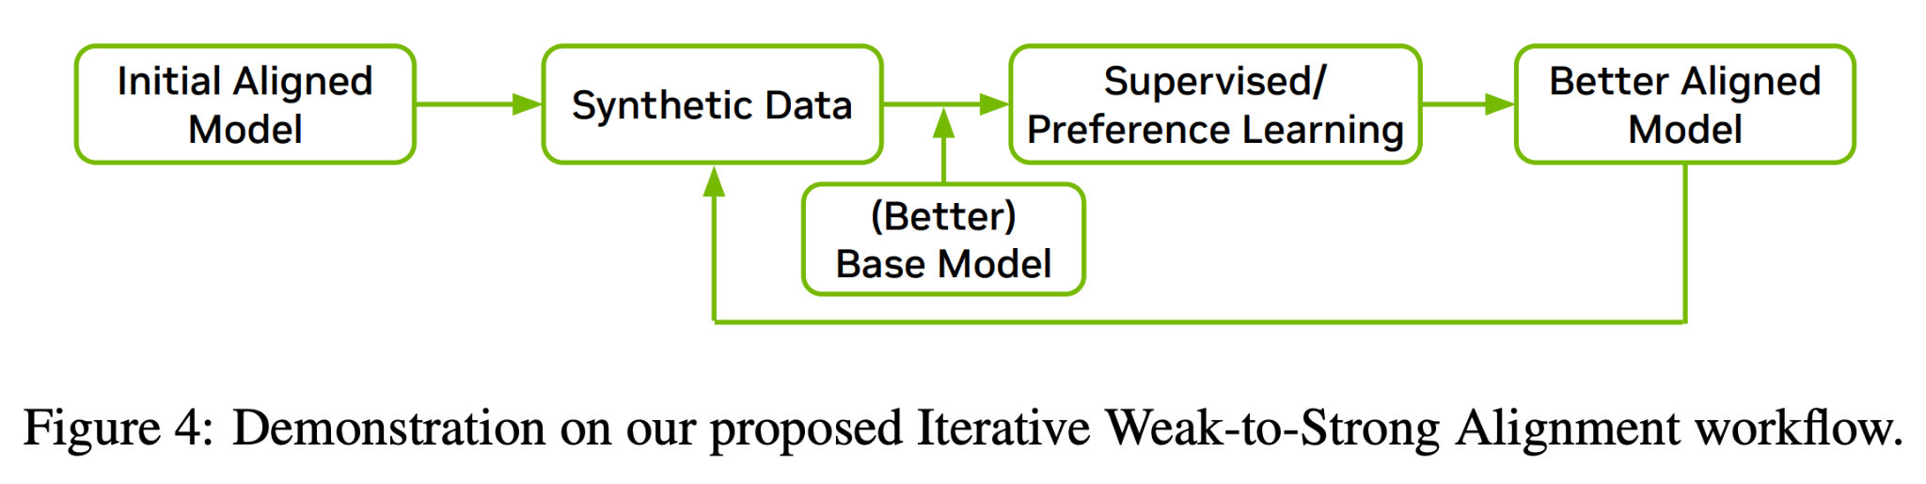
Current frontier model post-training
Adler, Bo, et al. 2024. Nemotron-4 340B.

Slide 14
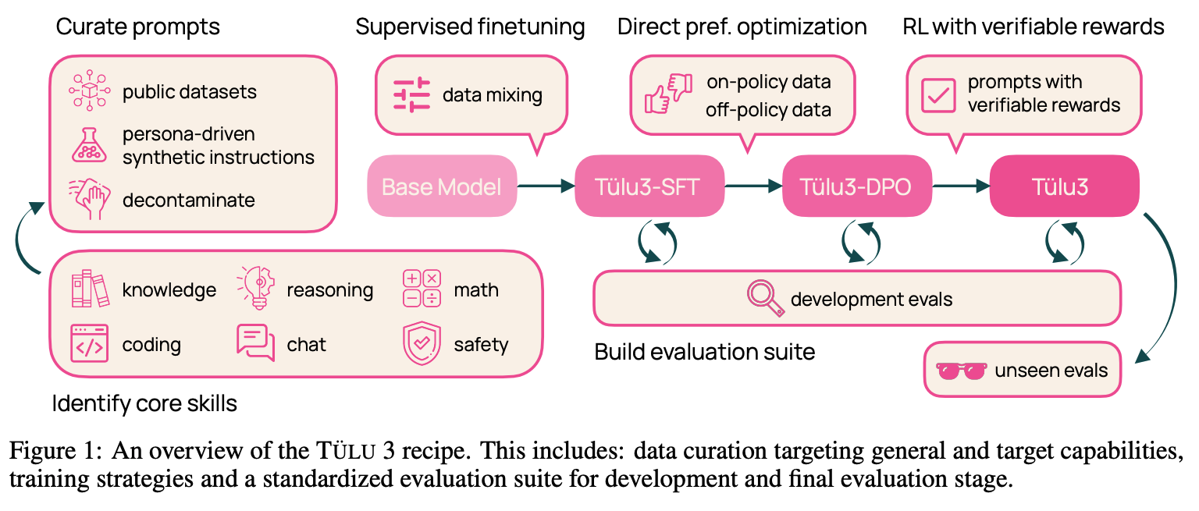
Current frontier model post-training
Lambert, Nathan et al. 2024. Tülu 3.

Slide 15
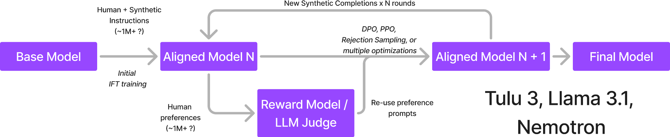
Two eras adaptation pipelines
From: https://www.interconnects.ai/p/frontier-model-post-training

Slide 16
Current frontier model post-training
Three training objectives are most popular:
Supervised Finetuning – teach formatting and for base of instruction following abilities.
Preference Finetuning – align to human preferences (and smaller bump in capabilities).
Reinforcement Finetuning – final stage to boost performance on verifiable tasks.

Slide 17
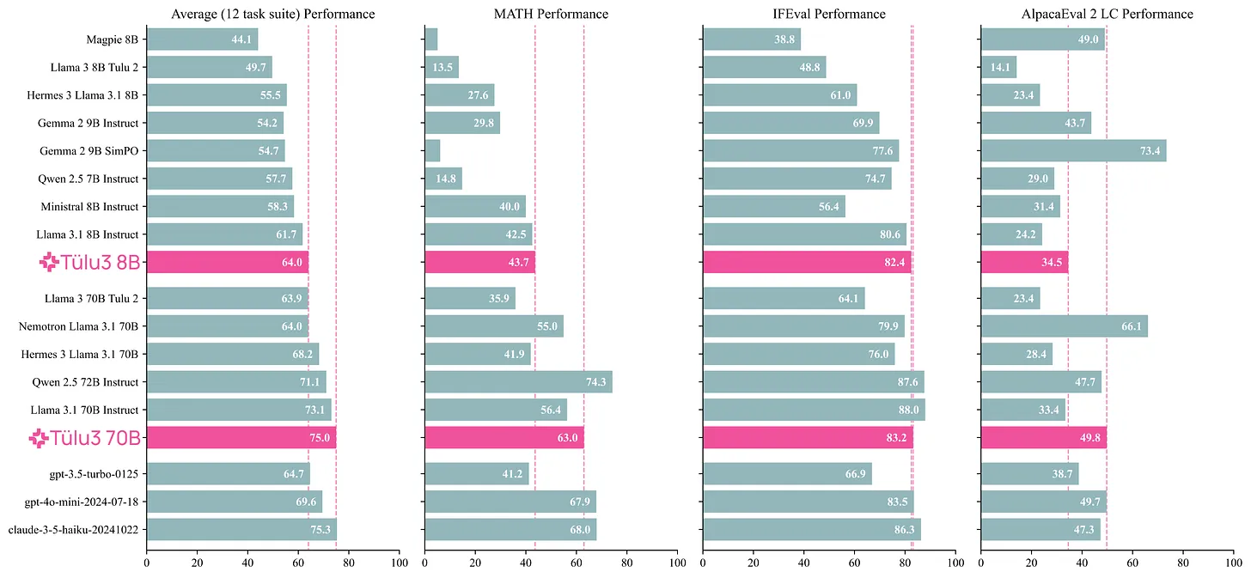
This talk includes examples from Tülu 3
Lambert, Nathan et al. 2024. Tülu 3.

Slide 18
Adaptation
Outline
Background & History
Prompts & Skill Selection
Supervised Finetuning (SFT) / Instruction Finetuning (IFT)
Preference Finetuning (PreFT)
RL and advanced tuning
Open questions

Slide 19
Getting the ingredients to start post-training
Successful adaptation starts with:
Meaningful evaluations for targeted skills, and
Prompts of representative queries for said skills.

Slide 20
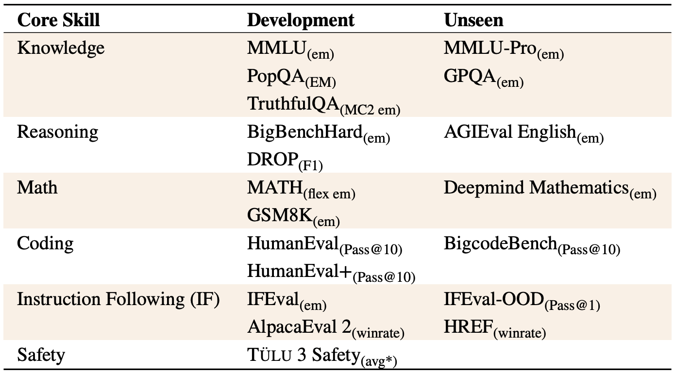
Getting the ingredients to start post-training: Evaluation
Post-training with modern language models can target:
Specialized models (0-3 skills): e.g. Math / Code models
General models (many skills): e.g. Instruct models
Example evaluation set from Tülu 3 general adapted models.
Unseen evaluations used to test generalization.
Lambert, Nathan et al. 2024. Tülu 3.

Slide 21
Getting the ingredients to start post-training: Prompts
All post-training stages require prompts in distribution of tasks.
Example prompt budget:
Supervised Finetuning – ~1 million.
Preference Finetuning – ~1 million, partial overlap with SFT can be useful.
Reinforcement Finetuning – ~10 - 100 thousand (data less available)
Large variance on these numbers is possible.

Slide 22
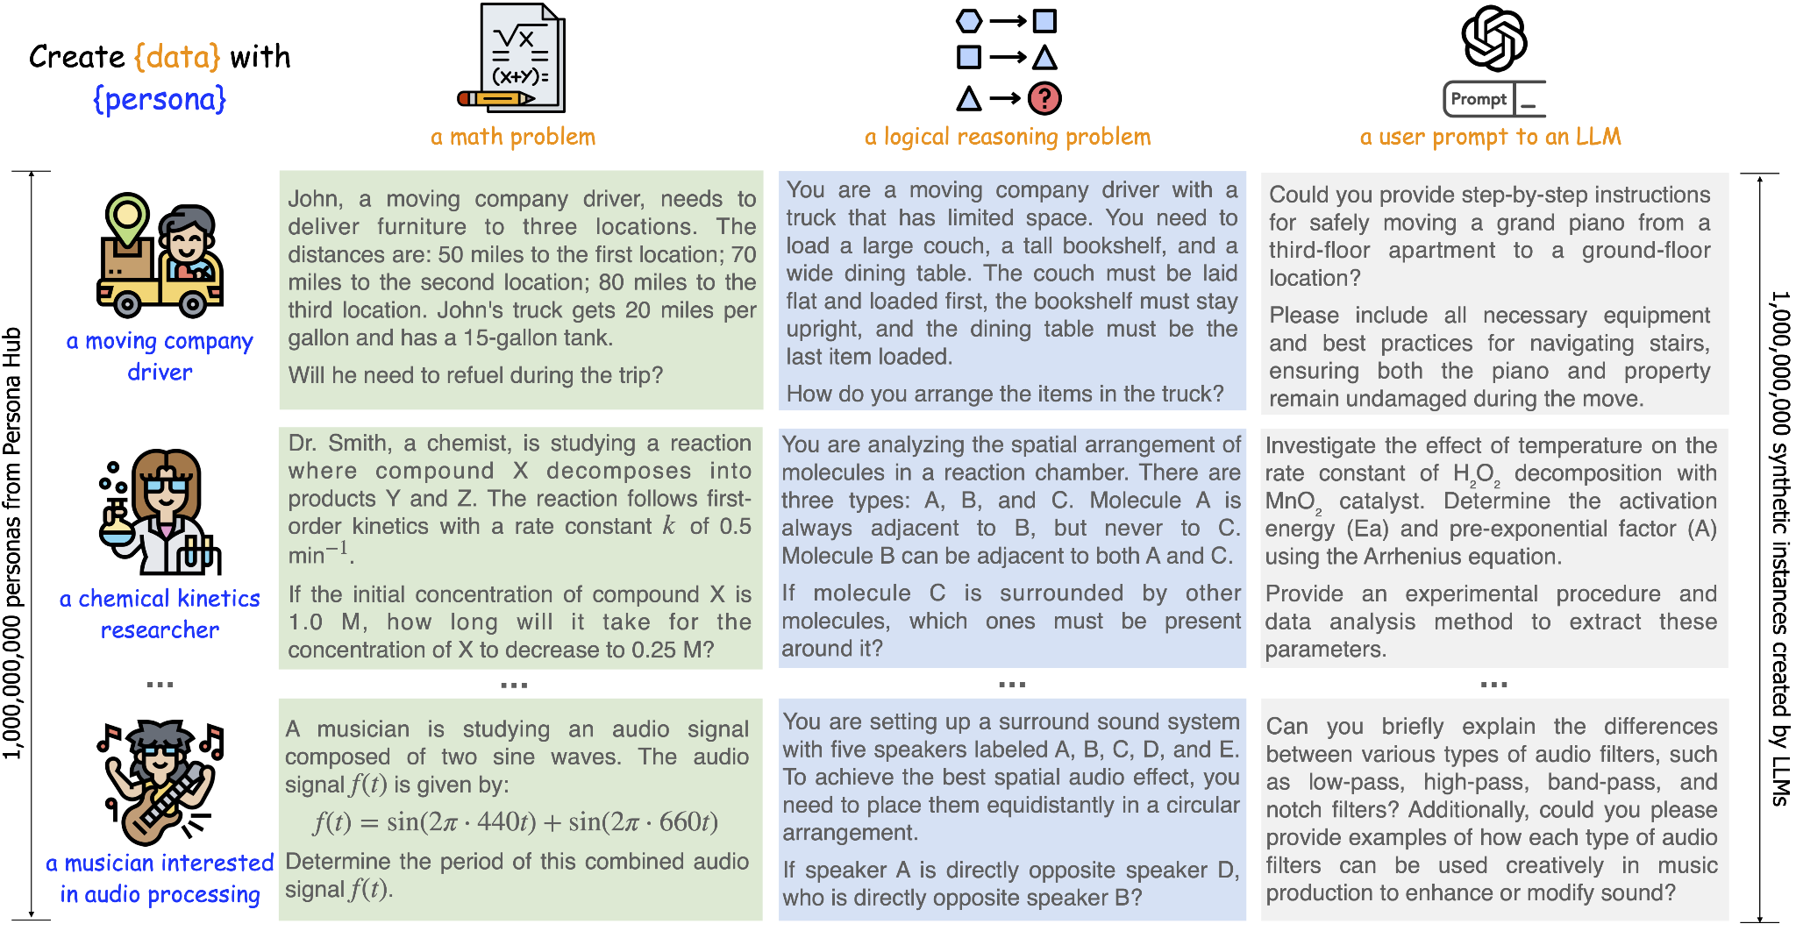
How we are improving MATH prompts
Creating high-quality, general math questions:
Prompt GPT-4o with “synthetic personas” to come up with advanced math problems
Filter top responses with Qwen 2 72B Math RM
PersonaHub: https://github.com/tencent-ailab/persona-hub

Slide 23
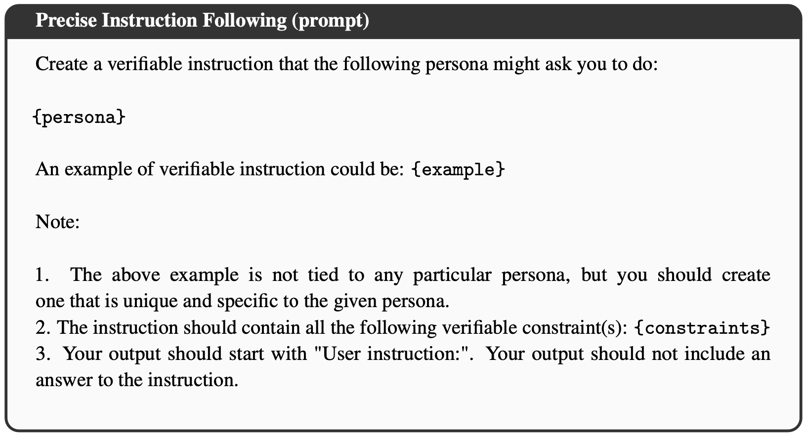
Example Persona prompt

Slide 24
Adaptation
Outline
Background & History
Prompts & Skill Selection
Supervised Finetuning (SFT) / Instruction Finetuning (IFT)
Preference Finetuning (PreFT)
RL and advanced tuning
Open questions

Slide 25
The role of instruction tuning
Accomplishes two primary tasks:
Adapt base model to specific style of input for chat interactions.
Ability to include system prompts, multi-turn dialogues, and other chat templates.
A very large proportion of post-training gains come from the SFT stage.

Slide 26
The role of instruction tuning
Accomplishes two primary tasks:
Adapt base model to specific style of input for chat interactions.
Ability to include system prompts, multi-turn dialogues, and other chat templates.
<|system|>
You’re a helpful agent
<|end|>
<|user|>
{query}
<|end|>
<|assistant|>{Answer goes here}
System prompt
Special
tokens

Slide 27
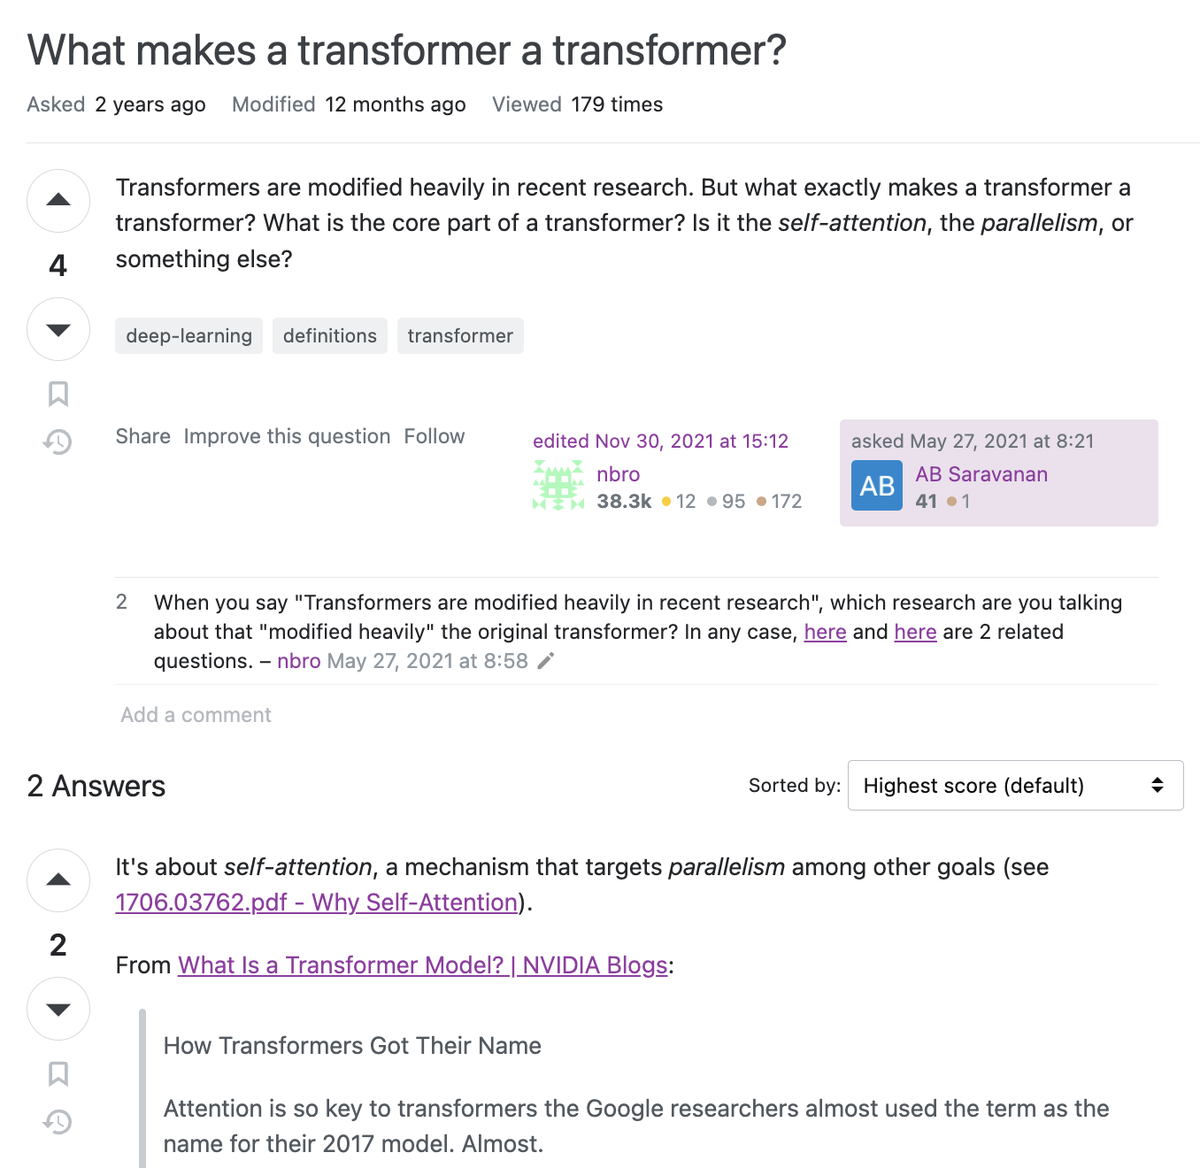
Example instruction
Stack Overflow :What makes a transformer a transformer?, nbro 2021

Slide 28
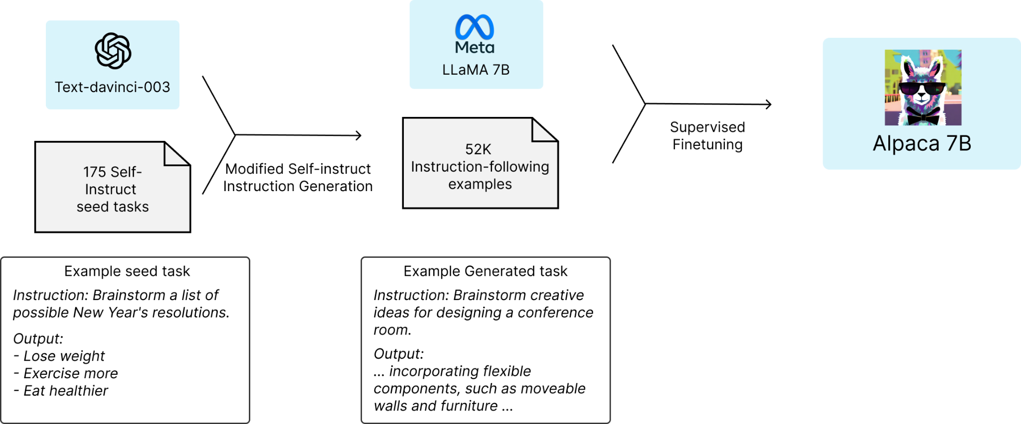
Key idea: Self-instruct / synthetic data
Start: N high-quality (often human) prompts
Ask a strong LM: Create a modified version of these instructions.
Generate completions with another (or same) strong LM.
End: easily 10x more (synthetic) training data!
(synthetic data = text generated by another LLM)
Taori et al. 2023. Alpaca.
Wang et al. 2022. Self-Instruct.

Slide 29

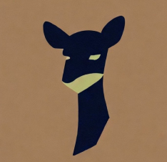
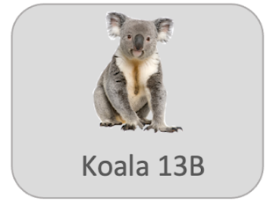

First open chat tuned models
Alpaca
13 Mar. 2023
52k self-instruct style data distilled from text-davinci-003
Model weight diff. to LLaMA 7B
https://crfm.stanford.edu/2023/03/13/alpaca.html
Vicuna (lmsys/vicuna-7b-delta-v0)
30 Mar. 2023
Fine-tunes ChatGPT data from ShareGPT
LLaMA 7B and 13B diff’s
Introduces LLM-as-a-judge
https://lmsys.org/blog/2023-03-30-vicuna/
Koala
3 Apr. 2023
Diverse dataset (Alpaca, Anthropic HH, ShareGPT, WebGPT…)
Human evaluation
LLaMA 7B diff.
https://bair.berkeley.edu/blog/2023/04/03/koala/
Dolly
12 Apr. 2023
15k human written data
Trained on Pythia 12b
https://www.databricks.com/blog/2023/04/12/dolly-first-open-commercially-viable-instruction-tuned-llm

Slide 30
SFT design process
Two repeated and parallelizable tracks:
Data mixing: Take existing datasets, combine them with existing mix, observe performance.
Substantial effort in trying to remove data and maintain performance.
Start fully with mixing before curation.
Data curation: Take evaluations you are behind on and create new data.

Slide 31
Building SFT data
Simple part of SFT data is “quality” of response:
Synthetic completions are used extensively. Strong models (GPT-4o, Llama 3.1 405B, etc.) are becoming more useful for generating completions to most instructions.
Human data is needed for out-of-distribution or new tasks.
[Optionally] Filter responses based on quality or correctness.
Largely undocumented is how to control “style” during SFT.

Slide 32
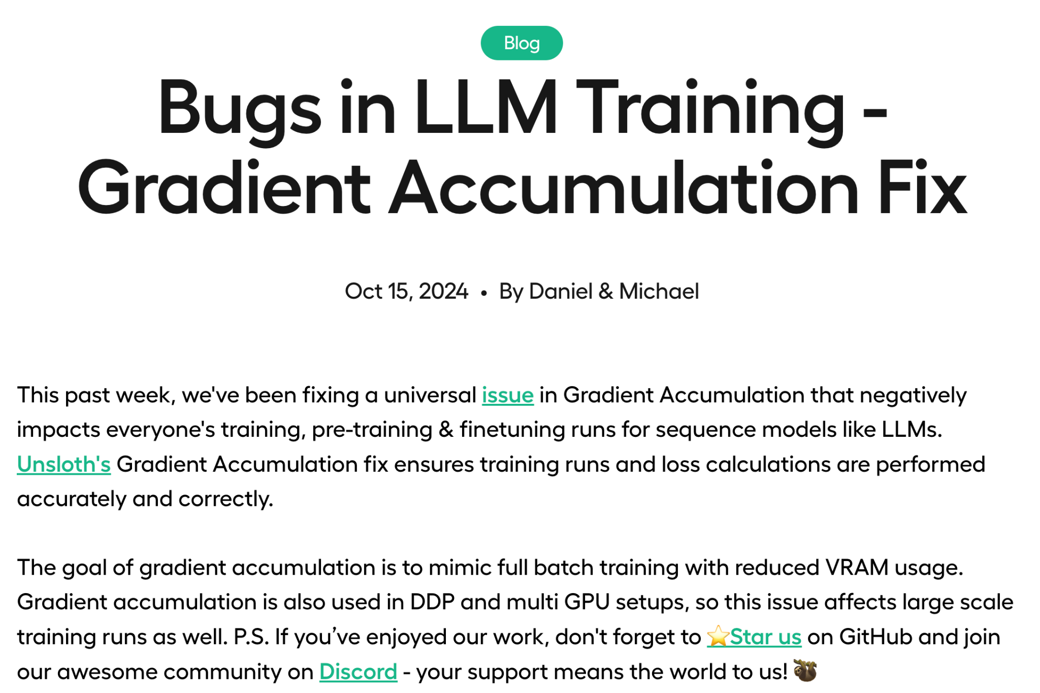
Be careful with implementation!
Now most people know there was a bug in HuggingFace gradient accumulation
We had found avoiding this bug was helping our models by >= 1 point average
https://unsloth.ai/blog/gradient

Slide 33
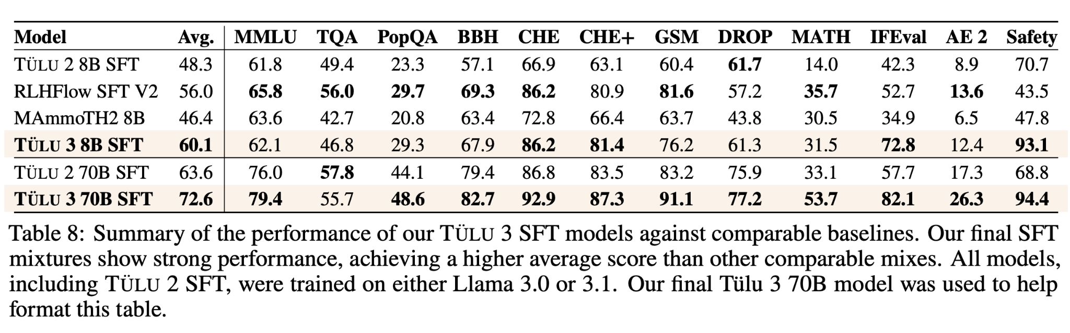
SFT performance potential
Still a lot of gains to be had with better suited SFT mixes.
Lambert, Nathan et al. 2024. Tülu 3.

Slide 34
Adaptation
Outline
Background & History
Prompts & Skill Selection
Supervised Finetuning (SFT) / Instruction Finetuning (IFT)
Preference Finetuning (PreFT)
RL and advanced tuning
Open questions

Slide 35
The role of preference finetuning (PreFT)
Aligning to human preferences gives:
Stronger training influence for style and chat evaluations (e.g. ChatBotArena).
Continue building capabilities of skills from SFT, but lower absolute magnitude of improvements.

Slide 36
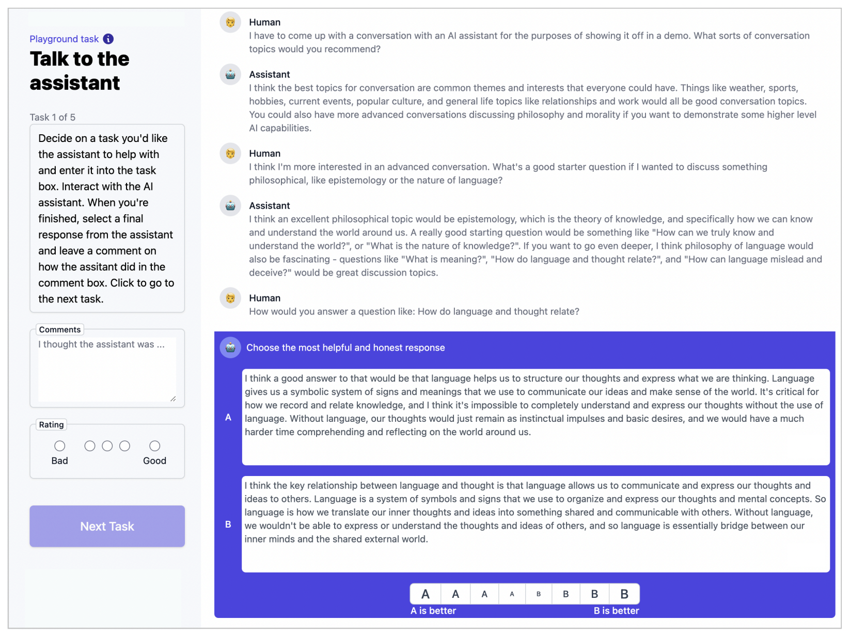
Getting preference data

Slide 37
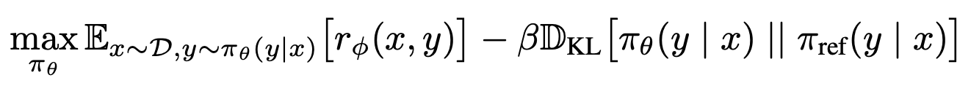
RLHF objective
π: LLM policy
π_{θ}: base LLM
x: prompt
y: completion

Slide 38
RLHF objective
π: LLM policy
π_{θ}: base LLM
x: prompt
y: completion
Optimize “reward” inspired ▲ by human preferences
▲ Constrain the model to not trust the reward too much (preferences are hard to model)

Slide 39
RLHF objective
π: LLM policy
π_{θ}: base LLM
x: prompt
y: completion
Optimize “reward” inspired ▲ by human preferences
▲ Constrain the model to not trust the reward too much (preferences are hard to model)
Primary questions:
How to implement reward: r(x,y)
How to optimize reward

Slide 40
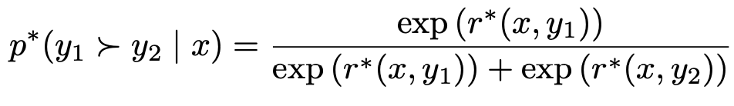
Preference (reward) modeling
Can we just use supervised learning on scores?
Assigning a scalar reward of how good a response is did not work
Pairwise preferences are easy to collect and worked!
Score from
optimal reward model
Chosen completion
Prompt
Key idea:
Probability ∝ reward
Rejected completion
Bradley Terry model: Estimate probability that a given pairwise preference is true

Slide 41
What if we just use gradient ascent on this equation?

Slide 42
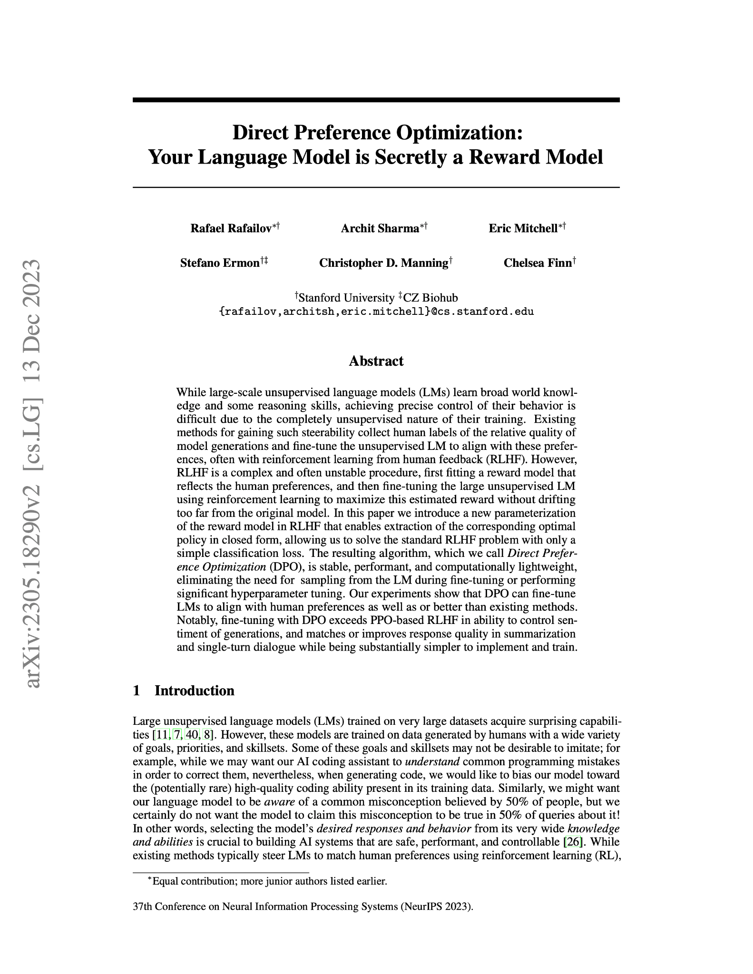
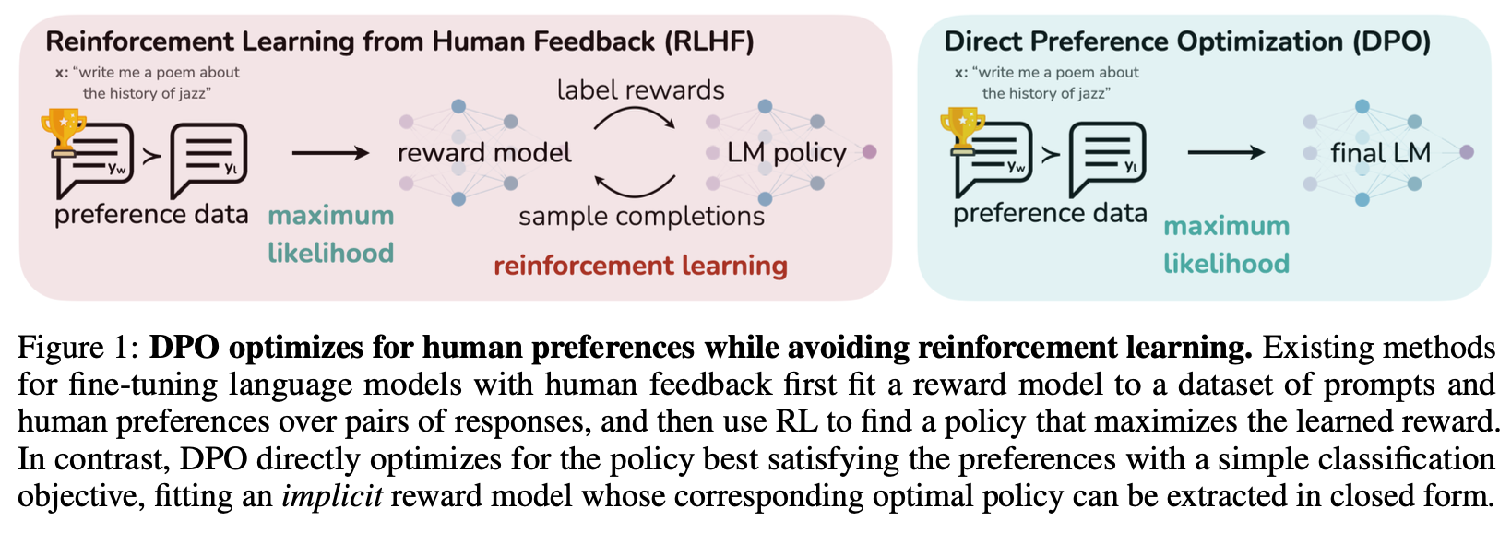
What if we just use gradient ascent on this equation?
The answer, with some math, is:
Direct Preference Optimization (DPO)
Released on May 29th 2023
Rafailov, Sharma, Mitchell et al. 2023

Slide 43
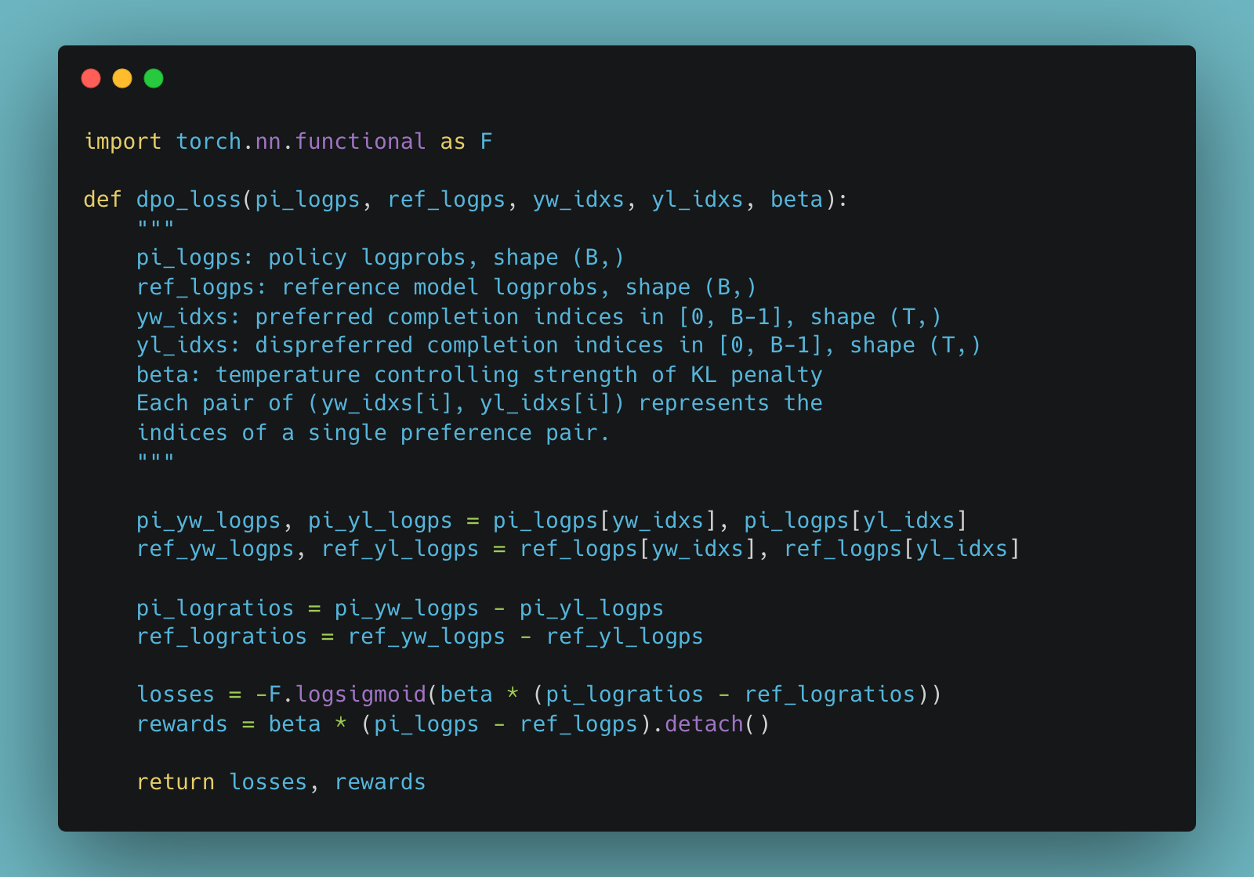
DPO core facts
Extremely simple to implement.
Scales nicely with existing distributed training libraries.
Trains an implicit reward function.
DPO is easier to iterate on, but slightly underperforms online RL methods on absolute potential.
Example code.
Rafailov, Sharma, Mitchell et al. 2023

Slide 44
DPO model proliferation
DPO gave us:
A faster, easier to implement baseline for iterating on post-training.
A massive proliferation of preference finetuning models and methods in the open.
Continue through today.

Slide 45
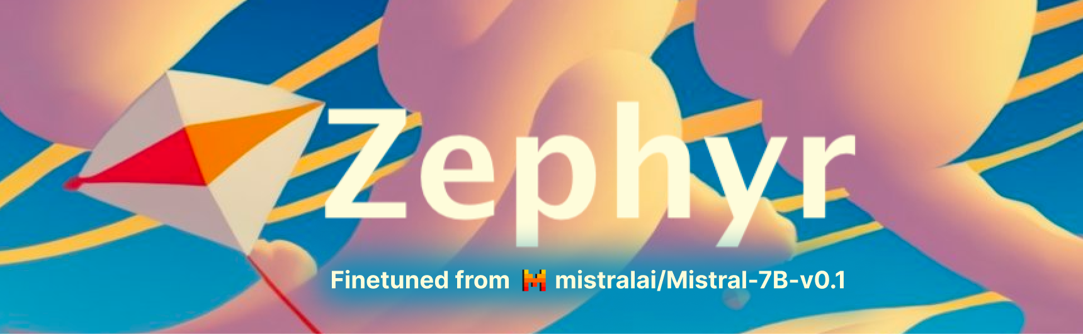
DPO model proliferation
HuggingFace H4’s Zephyr Beta
First model to make a splash with DPO!
Fine-tune of Mistral 7B with UltraFeedback dataset.
Discovered weird low learning rates that are now standard (~5E-7).
UltraFeedback: https://arxiv.org/abs/2310.01377
Model: https://huggingface.co/HuggingFaceH4/zephyr-7b-beta

Slide 46
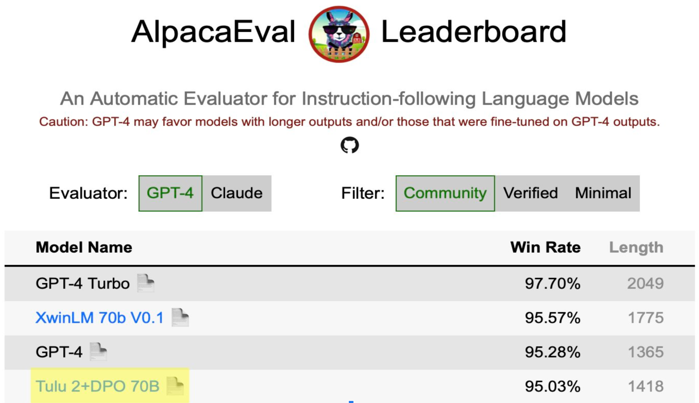
DPO model proliferation
Allen AI’s Tülu 2 70B
First to scale DPO to 70B parameters.
State-of-the-art open model on external benchmarks.
Open models began to match and surpass GPT-4.
Ivison et al. 2023. Tulu 2.

Slide 47
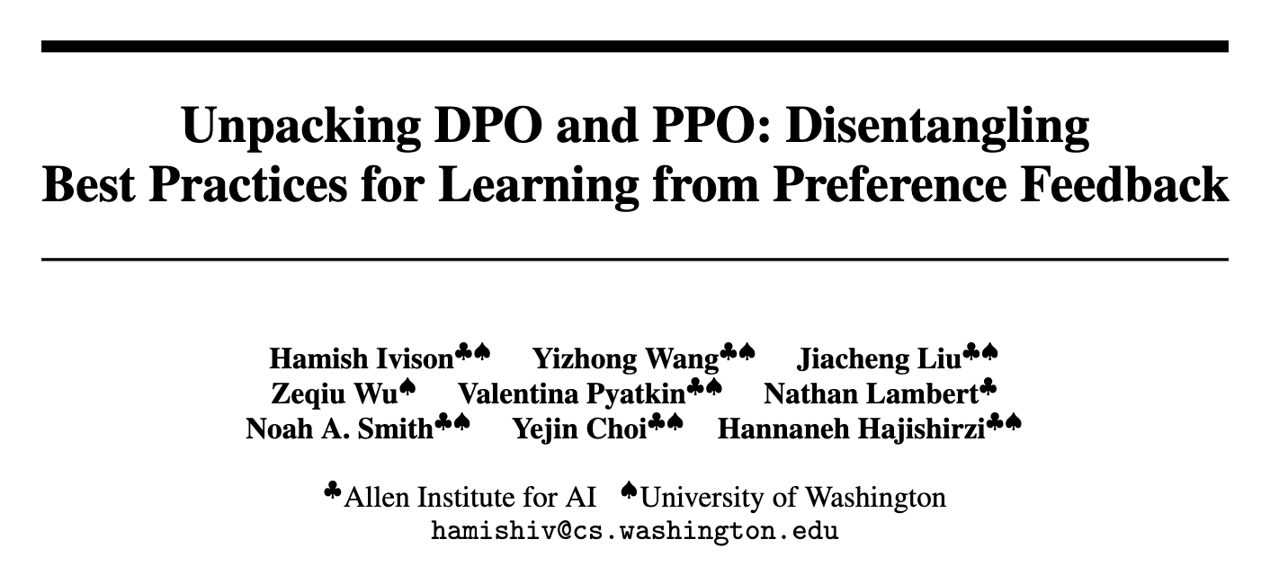
DPO vs RL (PPO, REINFORCE, …)
PPO consistently outperforms DPO, but at the cost of:
Implementation complexity
Memory usage, and
Throughput

Slide 48
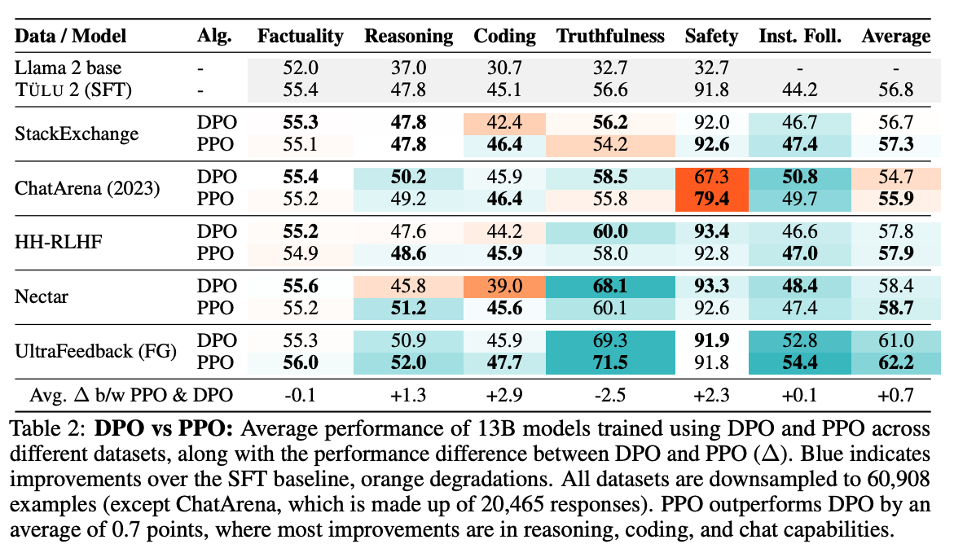
DPO vs RL (PPO, REINFORCE, …)
PPO consistently outperforms DPO, but at the cost of:
Implementation complexity
Memory usage, and
Throughput
Normally can get ~1% improvement from switching from DPO to PPO

Slide 49
Human preferences vs LLM-as-a-judge
Both sources of preference data are used extensively.
In frontier labs:
Human data used extensively as foundation of PreFT.
Synthetic data used to enhance behaviors (e.g. Constitutional AI).
In open research:
Synthetic data dominates due to price.
One LLM-as-a-judge label costs <1 cent.
One human datapoint costs $5-20.

Slide 50
Human preferences vs LLM-as-a-judge
Human data: High noise, low bias.
Synthetic data: Low noise, high bias.

Slide 51
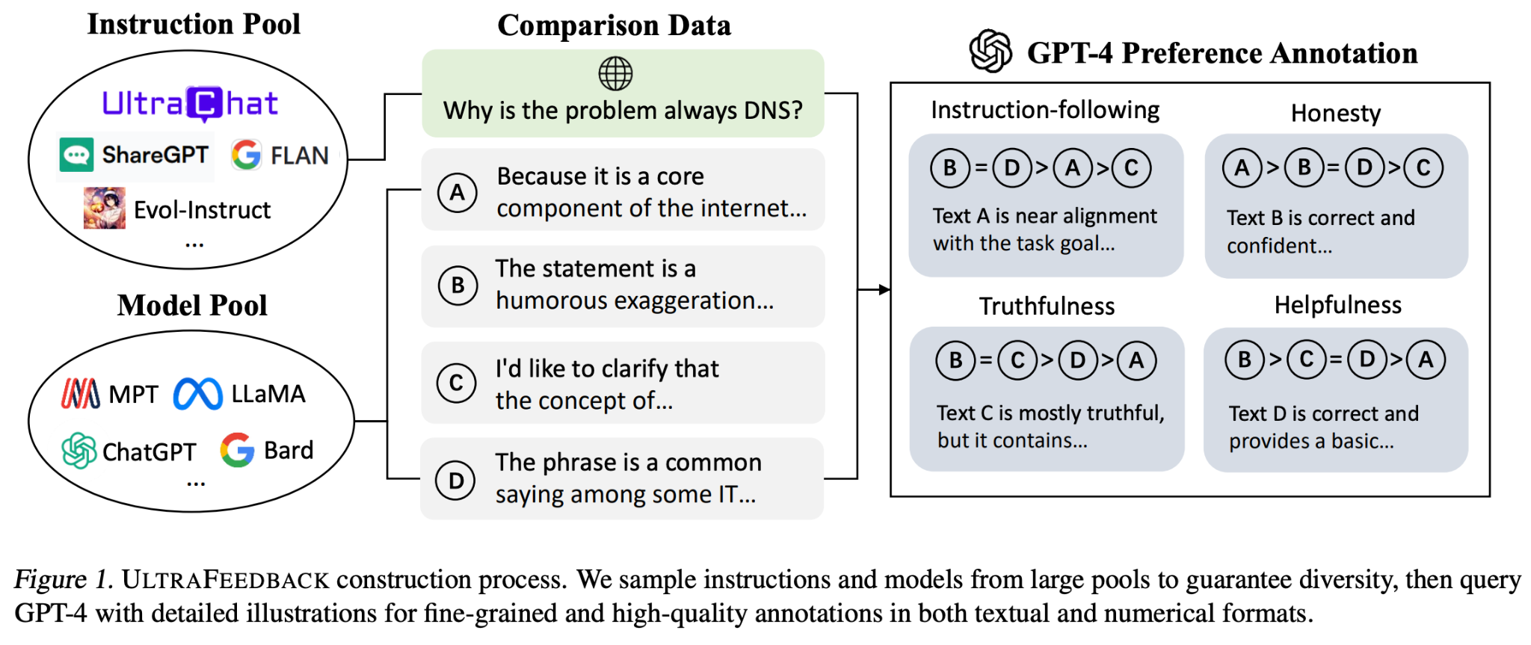
Leading synthetic preference data method: UltraFeedback
Key aspects:
Diverse model pool for completions.
Diverse prompt pool.
Extra performance is use on-policy generations from SFT checkpoint(s)
Cui, Ganqu, et al. 2024. UltraFeedback.

Slide 52
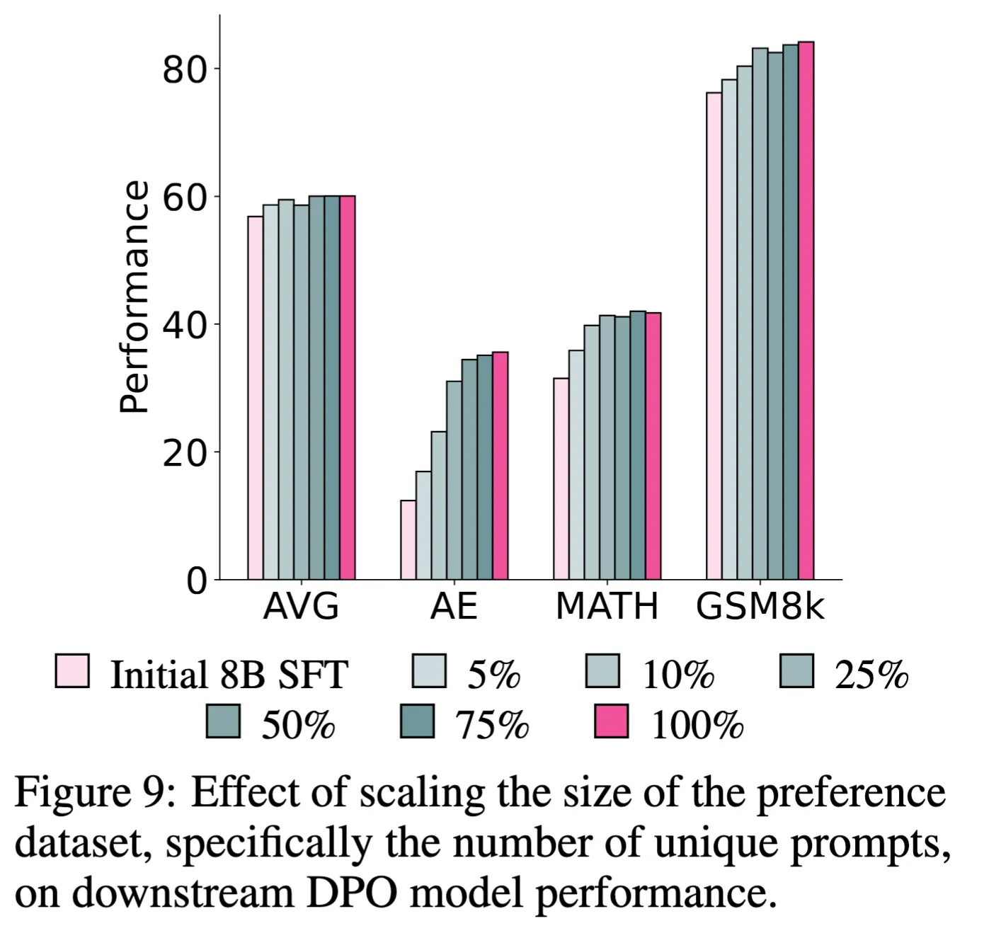
Scaling preference data
With a stable data pipeline, scaling from 10K’s to ~500K prompts (and beyond) yields simple performance gains.
Ultrafeedback ~60K prompts.
Tülu 3 ~300K prompts.
Lambert, Nathan et al. 2024. Tülu 3.

Slide 53
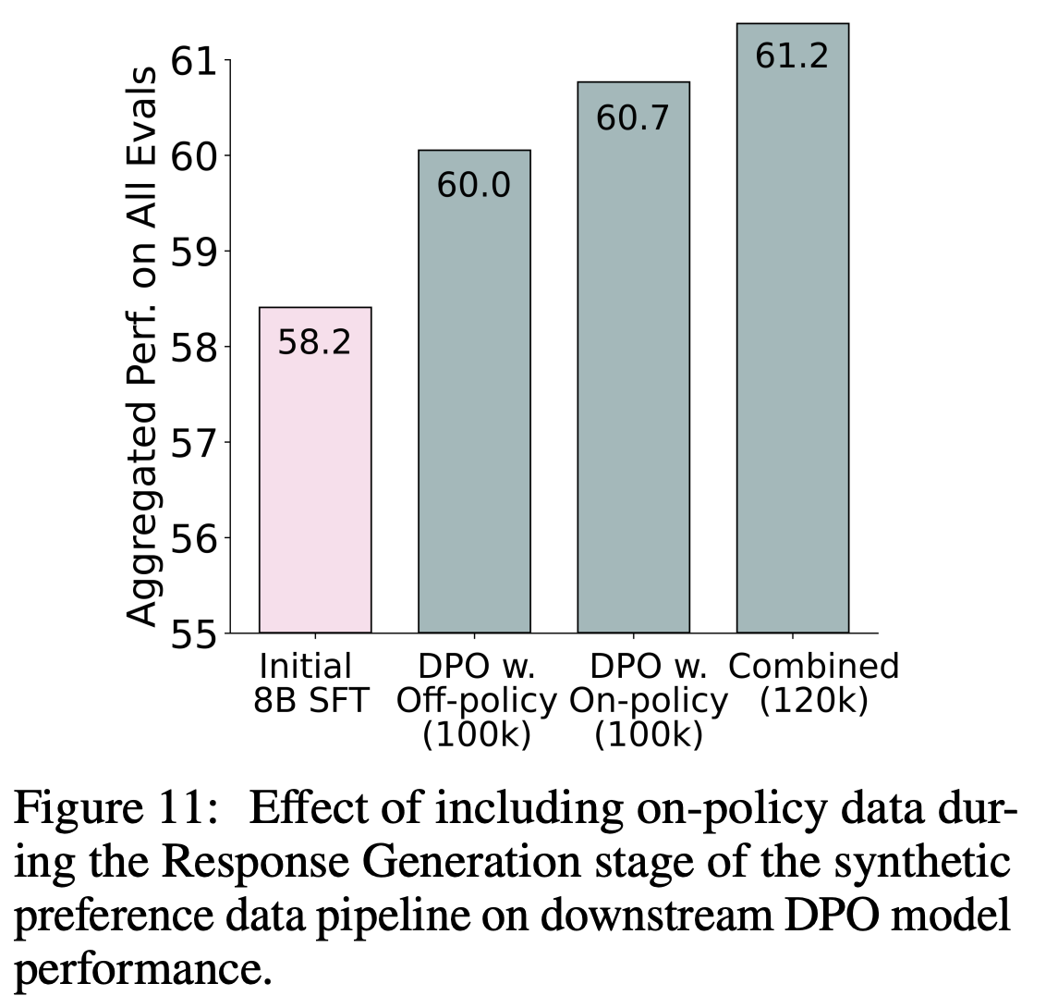
Gains from on-policy preferences
Best performance at DPO / Preference tuning stage by including completions from your preceding SFT model.
Note: Some recommend including some “chosen” completions in SFT stage.
Lambert, Nathan et al. 2024. Tülu 3.

Slide 54
Adaptation
Outline
Background & History
Prompts & Skill Selection
Supervised Finetuning (SFT) / Instruction Finetuning (IFT)
Preference Finetuning (PreFT)
RL and advanced tuning
Open questions

Slide 55
RL finetuning
Reinforcement learning as a training objective other than just for human preferences:
OpenAI's o1 and related models trained with "large-scale RL" for reasoning
Finetuning based on verifiable outputs:
Tülu 3's Reinforcement Learning with Verifiable Rewards (RLVR) or
OpenAI's Reinforcement Finetuning API
Extensive research in specific domains: Code verification, VinePPO for math, Quiet STaR, etc.

Slide 56
RL finetuning
Reinforcement learning as a training objective other than just for human preferences:
OpenAI's o1 and related models trained with "large-scale RL" for reasoning
Finetuning based on verifiable outputs:
Tülu 3's Reinforcement Learning with Verifiable Rewards (RLVR) or
OpenAI's Reinforcement Finetuning API
Extensive research in specific domains: Code verification, VinePPO for math, Quiet STaR, etc.

Slide 57
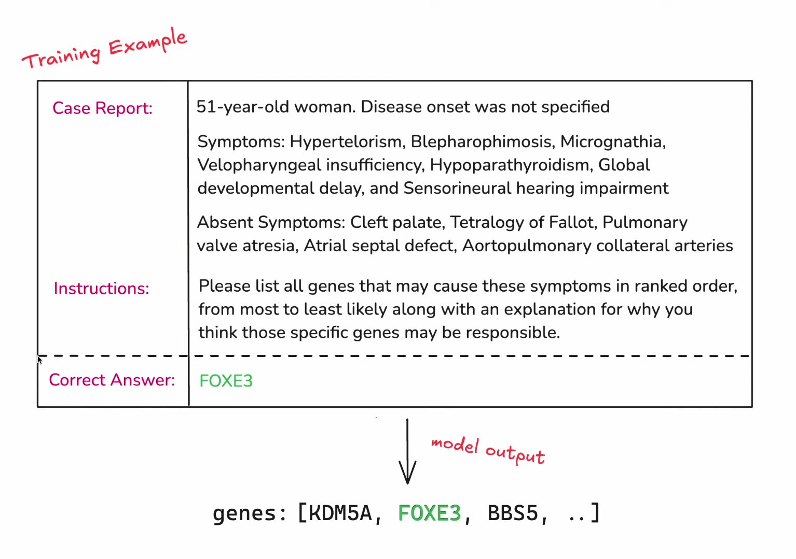
RL finetuning data format
Two components:
Prompt.
Answer.
Currently most popular for math and code, but expanding domains fast.
OpenAI’s example: Biology.

Slide 58
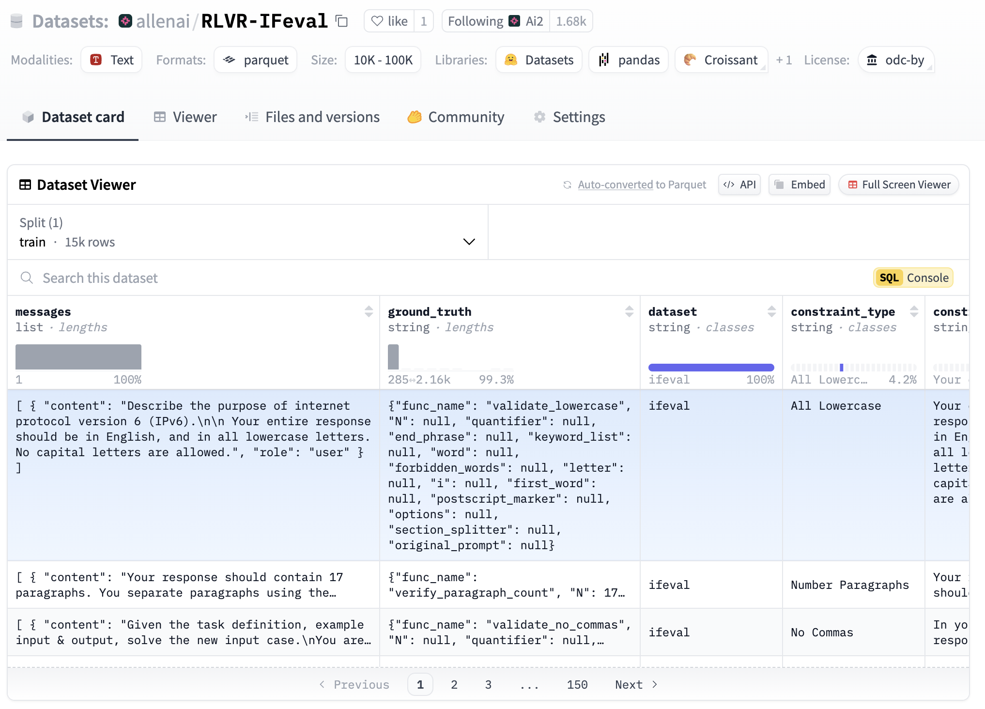
RL finetuning data format
Two components:
Prompt.
Answer.
Currently most popular for math and code, but expanding domains fast.
Tülu 3 example: Precise instruction following.
https://huggingface.co/datasets/allenai/RLVR-IFeval, Tülu 3

Slide 59
Implementing RL finetuning

Slide 60
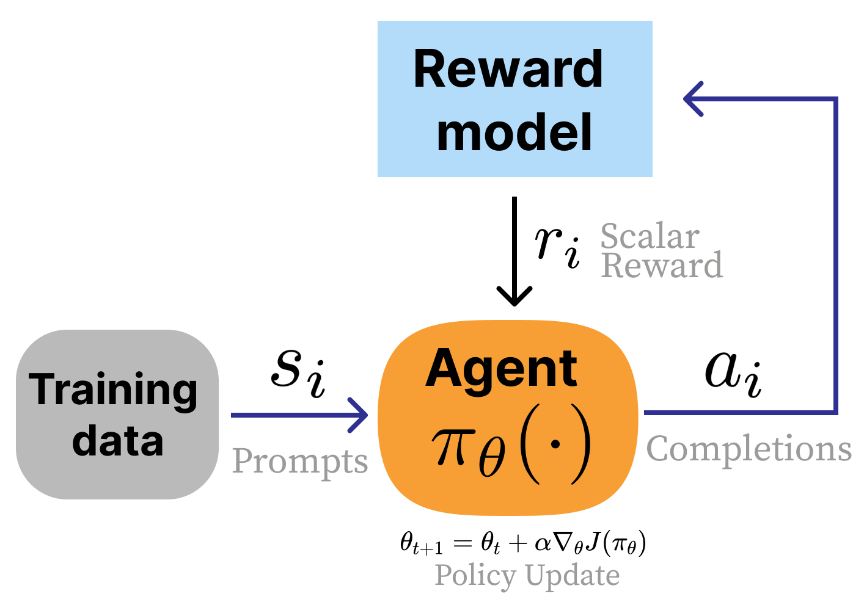
Start with:
Standard RLHF
Lambert, Nathan et al. 2024. Tülu 3.

Slide 61
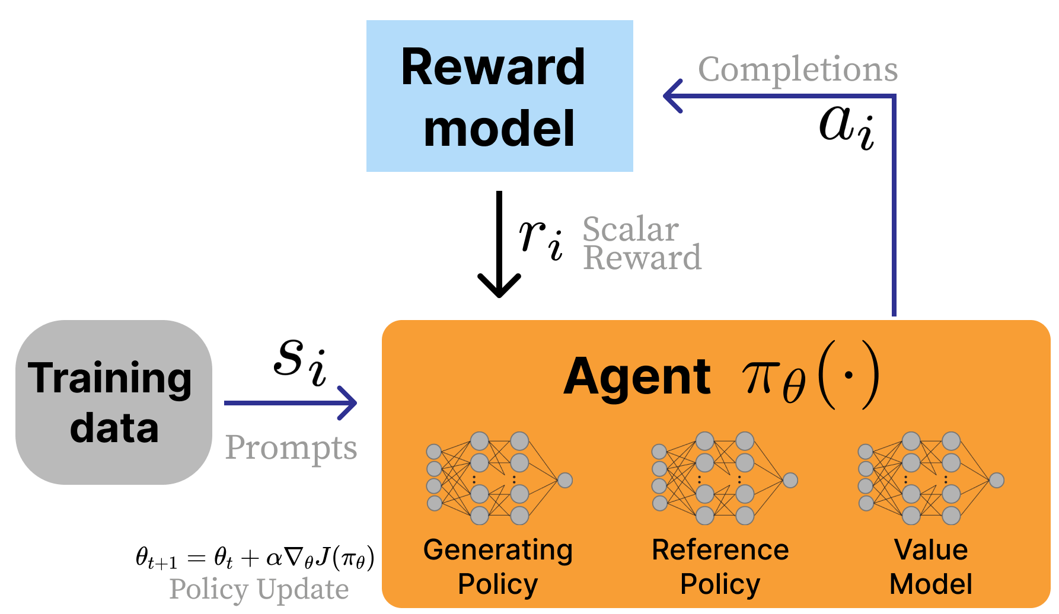
Standard RLHF (with RL details)
Lambert, Nathan et al. 2024. Tülu 3.

Slide 62
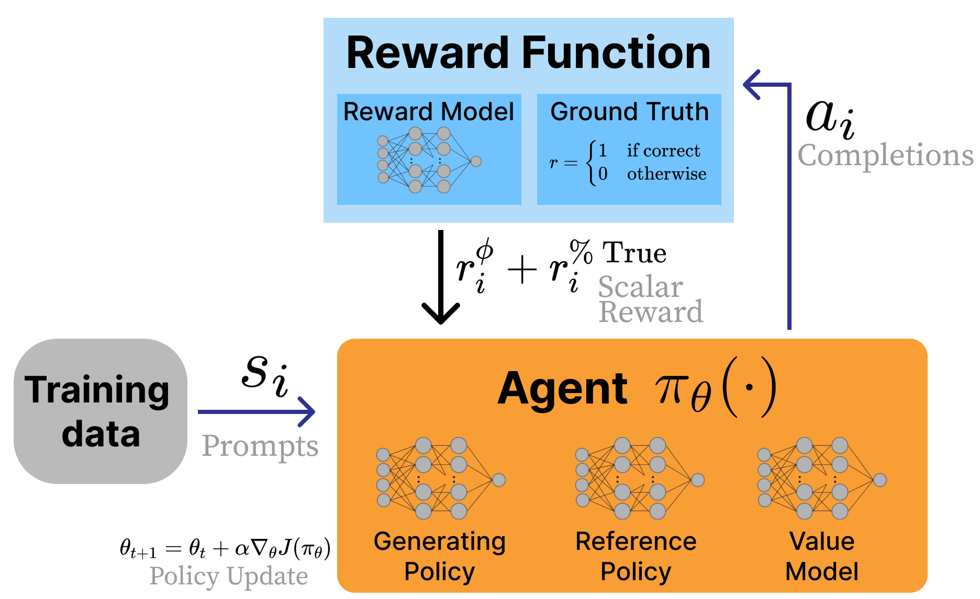
Adding verifiable rewards
Can we reward the policy for being correct?
Lambert, Nathan et al. 2024. Tülu 3.

Slide 63
RL with verifiable rewards details
1. We do not use a reward model! Just “environment” reward.
2. Value model init. from SFT / reward model, checkpoint, not random init.
Lambert, Nathan et al. 2024. Tülu 3.

Slide 64

Ground Truth RL
Lambert, Nathan et al. 2024. Tülu 3.

Slide 65
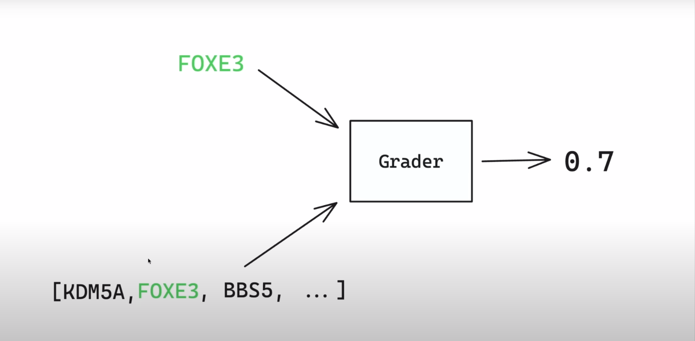
Answer extraction & grader models
For complex queries, extracting answer can be complicated.
E.g. .05 vs 1/20 vs \frac{1}{2} vs 5E-02 vs 5 x 10^-2…
OpenAI uses a specialized LM to extract answers.
Early replications can start with Python code based extraction.
This is the reward shaping from RL

Slide 66
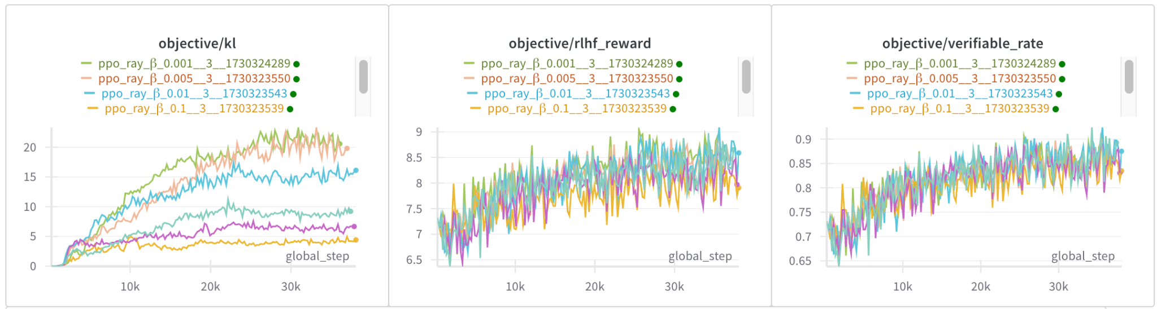
What training looks like
Very, very low KL distance relative to standard RLHF
Easy to saturate models on evals before RL stage → unclear how to sequence training

Slide 67
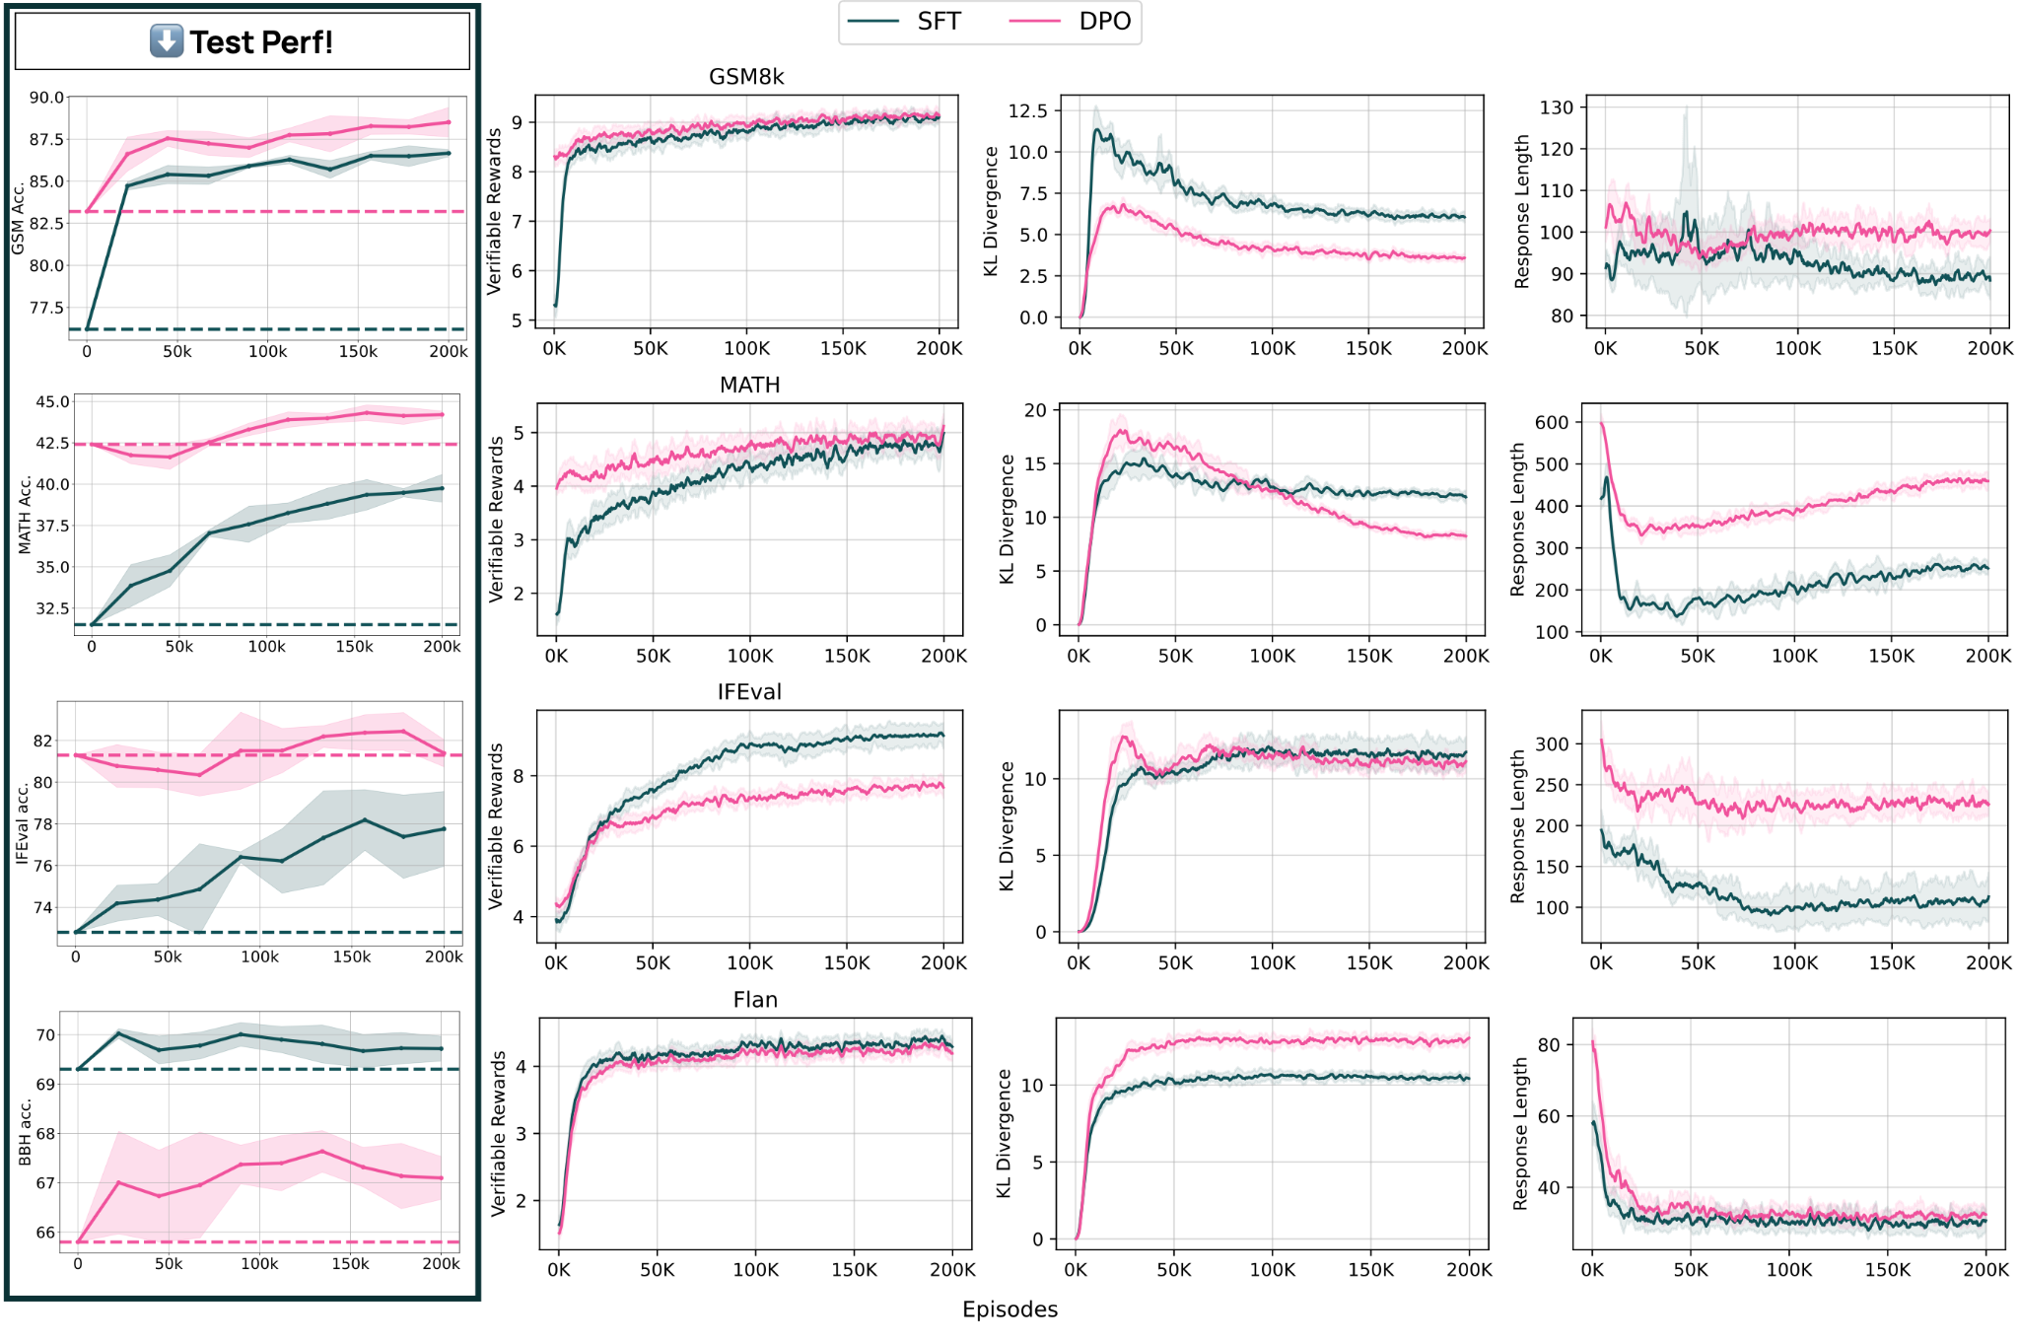
RL finetuning
learning / infra
in the open
Used very similar techniques to train Tülu 3 models.
https://github.com/allenai/open-instruct

Slide 68
What training looks like
“It just works” → lots of improvements to find with near-term research.

Slide 69
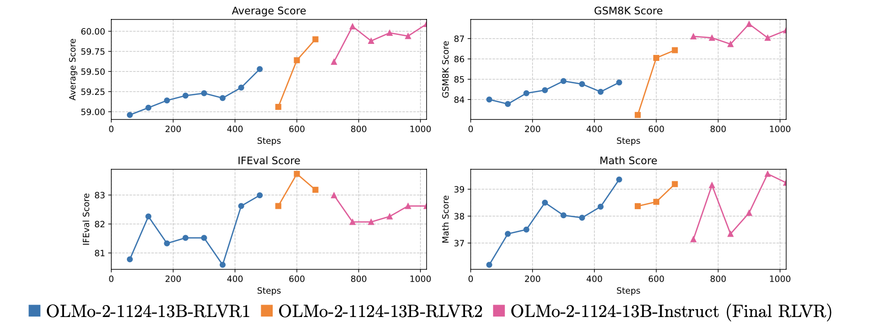
What training looks like
“It just works” → lots of improvements to find with near-term research.
Example: OLMo 2 chaining multiple RLVR stages

Slide 70
RL finetuning’s vs. with classical RL
RL with verifiable rewards and all forms of RL finetuning are extremely close to the classical definition of RL problems with reward given to correct behavior.
Main innovation is in stability of implementation without degradation across out-of-domain capabilities.

Slide 71
The big picture of RL finetuning
In many ways is very aligned with Yann's cake metaphor.
Foundation / pretraining is unsupervised learning.
SFT / PreFT is supervised learning.
RL is cherry on top to finalize behavior.
The boundary between post-training and other behaviors in language models is changing.

Slide 72
Adaptation
Outline
Background & History
Prompts & Skill Selection
Supervised Finetuning (SFT) / Instruction Finetuning (IFT)
Preference Finetuning (PreFT)
RL and advanced tuning
Open questions

Slide 73
Which base model?
Base or Instruct foundation:
Small changes → start from instruct model.
Many capabilities / bigger changes → start from base model.
Deciding on foundation:
Performance variations (and ceilings): Some models will illicit better behaviors for different different tasks! Try multiple, e.g. Mistral Large great for CLI.
Implementation variations: If building open-source models, some also have wildly different behavior in open source tools (e.g. Qwen 7B faster than Phi 3B in VLLM due to implementation issues).

Slide 74
Incremental post-training vs. distillation
Reality of open fine-tuning:
Distilling from a stronger model, such as GPT-4 or Llama 405B is a substantial shortcut in post-training.
We have almost no progress on creating powerful models without distillation.
Hope to address this soon.

Slide 75
Industrial post-training vs. academic progress
Post-training in industry is far more than methods presented:
User interfaces (UX),
Many, many more types of evaluations,
Re-training on user queries, etc.

Slide 76
Open questions in post-training
Methods and practices common in frontier laboratories but understudied in academic research:
How to use methods like rejection sampling.

Slide 77
Open questions in post-training
Methods and practices common in frontier laboratories but understudied in academic research:
How to use methods like rejection sampling.
How to train a good reward model.

Slide 78
Many reward model evaluations in 2024 (and not many training papers)
Accuracy based eval’s (first ones):
RewardBench: https://arxiv.org/abs/2403.13787
Multilingual RewardBench: https://arxiv.org/abs/2410.15522
RAG RewardBench: https://arxiv.org/abs/2412.13746
Preference correlation eval’s:
RMB: https://arxiv.org/abs/2410.09893
RM-Bench: https://arxiv.org/abs/2410.16184
Preference Proxy Evaluations: https://arxiv.org/abs/2410.14872
RewardMATH: https://arxiv.org/abs/2410.01729
Why optimizing for accuracy isn’t enough: https://arxiv.org/abs/2410.05584

Slide 79
Open questions in post-training
Methods and practices common in frontier laboratories but understudied in academic research:
How to use methods like rejection sampling.
How to train a good reward model.
The importance of human preference data vs. LLM-as-a-judge.

Slide 80
Open questions in post-training
Methods and practices common in frontier laboratories but understudied in academic research:
How to use methods like rejection sampling.
How to train a good reward model.
The importance of human preference data vs. LLM-as-a-judge.
Style/character training of LMs.

Slide 81
Conclusions

Slide 82












Research Still Needed
Science of LMs
Extend LMs Beyond Text
Use LMs in Real World
Improve LMs
LMs for Science
LM Agents
Build Next generation of LMs
LMs for Health
Planning
Test-time Inference
Mitigate LMs Risk and Biases
Efficient Models
Notes:
Of course not! There are still many challenges and research questions that need to be resolved.
Scientifically study LMs, improve them, and introduce their next generation.
Extend LMs beyond text in other domains such as vision, science, and health.
Use LMs in real world applications, mitigate their Biases and risks, improve and build AI agents,
And many fundamental research questions about reasoning, planning, test time inference.

Slide 83


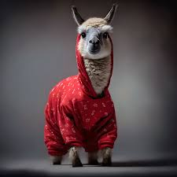

Training language models is a TON of details!
Stand on the shoulders of past research.
https://github.com/allenai/awesome-open-lms

Slide 84
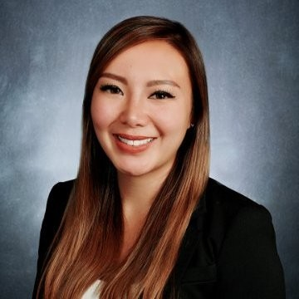
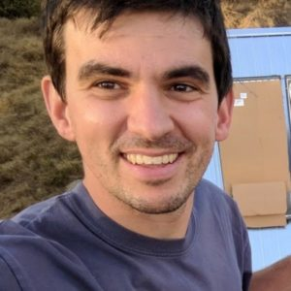
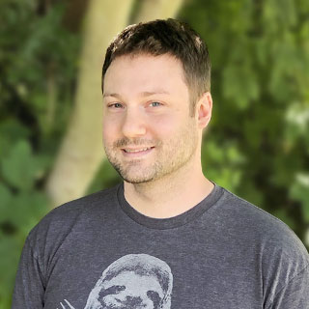
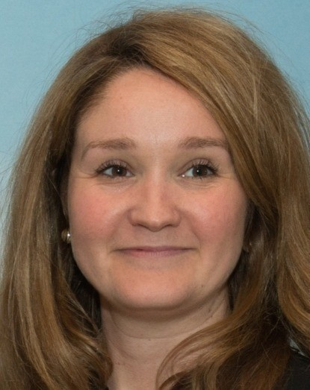






















































































olmo@allenai.org
… and many more (ordered arbitrarily)

Slide 85
Questions?
Try models built on this
https://playground.allenai.org/
Resources: https://github.com/allenai/awesome-open-lms

